Slide 1
G.R.A.N.T. Forum
Grant Research Administrator Network Team
Award Kick-off: Notice of Grant Award, PIN…Now What?
November 16th 2021
_{OFFICE OF RESEARCH AND} _{SPONSORED PROGRAMS}
Notes:
Speaker: Shala

Slide 2
G.R.A.N.T. Forum
Introductions:
Shala Bonyun, Associate Director
Pre-Award Services
Rebecca Hanson, Assistant Director
Post-Award Services
Tracey Poston, Assistant Director
Research Compliance and Integrity
Notes:
Speaker: Shala

Slide 3
Agenda
Part I: Proposal to Award
Project Plan
Activities and Timelines
Effort and Resources
Part II: Interpreting a Notice of Grant Award, Research Agreement or Contract
Reviewing an Award Document
Award Attributes
Terms and Conditions
Identifying What’s Important and Why
Common Pit-Falls
NoGA and Research Agreements
Part III: Project Kick-off
ORSP Project Information Notification (PIN) Report
Roles and Responsibilities
Notes:
Speaker: Shala

Slide 4
Part I: Proposal to Award Project Plan Effort and Resources
Notes:
Speaker: Shala

Slide 5
Project Plan
Proposed Research Plans and Narratives become the Project Plan within an Award. Research Plans include:
Project Description
Scope/Statement of Work
Specific aims/goals
Timelines including Tasks, Deliverables and milestones
Data Management and Dissemination (i.e.)publication of data and results
Notes:
Speaker: Shala

Slide 6
Effort and Resources
Proposed Effort for Team Members become the committed effort within an Award. Team members and participants include:
Key Personnel: PI, co-PI, co-I
Non-Key personnel: Post-Doc, RA, Project Mangers and Coordinator
Collaborators: Subrecipients (names/approved, unfunded, TBD)
Notes:
Speaker: Shala

Slide 7
Effort and Resources
Proposed Budgets and Budget Justifications become approved budget plans in an awards with terms and conditions for allowability, payments/reimbursements and modifications based on the original budgets.
Expected Personnel
Subrecipient Awards
Equipment Purchases
Human Subjects (Gift Cards & Cash Advances)
Travel Reimbursements
Notes:
Speaker: Becky

Slide 8
Effort and Resources
Proposed participant support cost (reimbursements, stipend levels), research subject inclusion and compensation become strict targets and are subject to special restrictions in an award. Participants and Subjects Activities and Costs include:
Trainees and Fellowship Stipends
Study Participants (e.g. workshop attendees' reimbursements and incentives)
Human Subjects Compensation and Incentives
Notes:
Speaker: Becky

Slide 9
Effort and Resources
Proposed Cost-Share and Institutional Resources become measurable award commitments which require certification and are often required to illustrate program sustainability at award closeout. These commitments include:
Direct Costs such as RA Tuition Waivers, in-Kind Effort
Applicable F&A on Cost-share direct costs, unrecovered F&A, restricted pr waived F&A
Space, instrumentation, donated expertise
Unfunded collaborators and third-party cost-share
Institutional Resources to support Program sustainability after award ends
Notes:
Speaker: Shala

Slide 10
Proposal to Award
Proposal Elements | Award T&Cs
Research Plan | Project Plan and SOW
Application Attachments | Budget and Spending Plan
Project Teams | Key, non-Key Personnel, Approved Subawardees and consultants and evaluators
Participants | Trainee or Fellow Cohorts
Research Targets | Enrolled Humans Subjects, Research Sites and Locations
Notes:
Speaker: Shala

Slide 11
Proposal to Award Proposal Narratives, Application Attachments Compliance Certifications, Project teams, Participants and Subjects become the basis for Award Terms and Conditions
Notes:
Speaker: Shala

Slide 12
Part II: Interpreting a Notice of Grant Award Award Attributes Reviewing an Award Document Terms and Conditions NoGA and Research Agreements
Notes:
Speaker: Shala

Slide 13
Award Attributes
Attributes of an Award include:
Sponsoring Agency or Organization
Start and End Dates
Project Titles
PI & Key Personnel
Budget Periods
Award Amounts
Award Type and Billing Requirements
Reporting Requirements
Compliance
Notes:
Speaker: Shala

Slide 14
Reviewing an Award Document
Information in a typical Award Notice or Agreement include:
Project/Program Description or Statement of Work
Project/Program Personnel and Collaborators
Grantee(UMB) and Grantor (Sponsor) Points of Contact
Budget and Project Periods of Performance
Budget Details
Award Type & Billing Requirements
Reporting Requirements
Sponsor Policies and Procedures (P&Ps)
Applicable Regulations and Compliance Certification
Award Terms and Conditions (T&Cs)
Notes:
Speaker: Shala

Slide 15
Terms and Conditions
Identifying What’s Important and Why
Common Pitfalls
Notes:
Speaker: Shala

Slide 16
What’s Important and Why
Common Terms and Conditions (T&Cs)
Award Policies and Procedure (P&P)
Sponsor’s award policies are often incorporated by reference within the award documents
Special P&Ps are explicitly articulated in the award documents (i.e. Clinical Trials, Publications)
Notes:
Speaker: Shala

Slide 17
What’s Important and Why
Common Terms and Conditions (T&Cs)
Institutional Responsibilities (OMB, regulations and internal controls)
Proposal eligibility requirements and certifications often become award T&Cs (i.e. COI, RCR).
Compliance with federal regulations (i.e. drug-free workplace), Active internal Controls (and consistent policies and procedures (HR, procurement) related to award activities.
T&Cs can become Audit Criteria
Notes:
Speaker: Shala

Slide 18
What’s Important and Why
Common Terms and Conditions (T&Cs)
Prior Approvals and Notifications
Expanded Authorities on Federal awards
Knowing which award changes require prior approval or notification
Critical guidelines and deadlines for submitting prior approval and notification
Timelines and requirements for Amendments, Continuations and Extensions
Notes:
Speaker: Shala

Slide 19
What’s Important and Why
Common Terms and Conditions
Programmatic and Financial Reporting Requirements
Interim, annual reports can be required for future budget periods and non-competing continuations
Guidelines on the frequency, format and content of reports can be found in the terms and conditions of an award
Consequences of Non-compliance with reporting requirements are sometimes outlined in T&Cs
Future eligibility and funding can be contingent on compliance with current or previous awards T&Cs
T&Cs can become Audit criteria
Notes:
Speaker: Becky

Slide 20
What’s Important and Why
Common Terms and Conditions
Billing Requirements: How the sponsor expects to send UMB award funds (cash) for performance received.
Basis of Billing
Cost Reimbursement (Expenses)
Fixed Price/Flat Fee
Cost per Deliverable
Immediate Payment (Advance)
Frequency
Monthly, Quarterly, Deliverable Schedule
Notes:
Speaker: Becky

Slide 21
What’s Important and Why
Common Terms and Conditions
Deliverables: The tangible products expected to be transferred from UMB to the sponsor. Examples include:
Data Sets & Publications
Meetings & Presentations
Evaluations and Reports
Compounds, Samples or Materials
Notes:
Speaker: Shala

Slide 22
What’s Important and Why
Common Terms and Conditions
Closeout: Final reconciliation of the Project and Award at the end of the Period of Performance or Award end date.
Final Deliverables, reports and invoices
Invention Disclosures
Notes:
Speaker: Becky

Slide 23
What’s Important and Why
Common Terms and Conditions (T&Cs)
Conflict Interest & Conflict Commitment
Disclosure Procedure: Key personnel must disclose all potential COIs and COCs.
Conflict Mitigation: The appropriate UMB official must then evaluate the potential conflict, and if it is found to be significant, must manage it.
University policy and federal regulations require to update disclosures within 30 days of acquiring or discovering a new outside interest.
Notes:
Speaker: Tracey. All faculty investigators, and key personnel in the research, who have responsibility for the design, conduct, or reporting of the research must disclose any personal financial interests that reasonably appear to be related to the project.
In addition, key personnel must disclose activities that may appear to interfere or compete with the project's completion, ability, or willingness to perform his or her responsibilities. This also includes any foreign engagements.

Slide 24
What’s Important and Why
Common Terms and Conditions (T&Cs)
Research Compliance and Integrity (Human, Animal, Education)
Certification of IRB Approval. If the proposed project involves human subjects research, must be approved by an IRB. Pending or expired approvals are not acceptable.
Verification of IACUC Approval. If the proposed project involves research with live vertebrate animals, verification of the date of IACUC approval. Pending or out-of-date approvals are not acceptable.
Notes:
All faculty investigators, and key personnel in the research, who have responsibility for the design, conduct, or reporting of the research must disclose any personal financial interests that reasonably appear to be related to the project.
In addition, key personnel must disclose activities that may appear to interfere or compete with the project's completion, ability, or willingness to perform his or her responsibilities. This also includes any foreign engagements.

Slide 25
What’s Important and Why
Common Terms and Conditions (T&Cs)
Research Compliance and Integrity (Human, Animal, Education)
Human Subjects Education Requirement. If the proposed project involves human subjects research, certification that any person identified as senior/key personnel has completed an education program in the protection of human subjects must be submitted.
RCR "Responsible Conduct of Research"
Notes:
Speaker: Tracey
NIH mandates that trainees on an NIH institutional research training grant, individual fellowship, career development award (institutional or individual), research education grant, dissertation research grant, or other grant programs that have a significant training component have a minimum of eight hours of formal instruction at least once during each career stage and at least every four years.
In addition, key personnel must disclose activities that may appear to interfere or compete with the project's completion, ability, or willingness to perform his or her responsibilities. This also includes any foreign engagements.
Responsible conduct of research (RCR) includes most of the professional activities that are part and parcel of a research career. As defined by federal agencies, RCR encompasses the following nine areas:
Collaborative Science Collaborations take place in a variety of forms, including the borrowing and lending of supplies, resources and equipment between researchers; seeking input from an expert in a different discipline; and partnering with colleagues who have a similar background or field of knowledge for fresh ideas and abilities.
Conflicts of Interest and Commitments Conflicts of interests or commitments are not inherently negative; rather, the way in which the conflict is managed is important.
Data Acquisition, Management, Sharing and Ownership
Human Research Protections Research with human participants plays a central role in advancing knowledge in the biomedical, behavioral, and social sciences.
Lab Animal Welfare APA has and continues to support efforts to improve laboratory animal welfare through the implementation of policies and regulations that both maintain the integrity of scientific research and sustain the welfare of such animals.
Mentoring Mentoring a less-experienced researcher is a professional responsibility of all scientists. The ultimate goal of the mentor is to establish the trainee as an independent researcher.
Peer Review Positive peer reviews contribute to increased funding opportunities, academic advancement, and a good reputation.
Publications Practices and Responsible Authorship Although researchers can disseminate their findings through many different avenues, results are most likely to be published as an article in a scholarly journal.
Research Misconduct Institutions should have procedures in place to investigate and when appropriate report findings of misconduct to the Office of Research Integrity (ORI). They should also have policies that protect both whistleblowers and the accused until a determination is made. FFP

Slide 26
Data Management and Sharing
Common Terms and Conditions (T&Cs)
Data Management, Sharing, Dissemination and Publication, Requirements
Work out in advance.
Who owns the data?
What are the rights to publish the data?
Does collecting data impose any obligations to PI or Institution. (Confidentiality Agreements)
Notes:
Speaker: Tracey.
Preferably in writing.
May need institutional approval!
Data should be preserved – but for how long?
At least 3-7 years?

Slide 27
What’s Important and Why
Common Terms and Conditions
Be aware of award conditions that supersede the general P&Ps
Allowable Sponsor activities and expenses may be restricted by institutional P&P.
Examples include:
Compensation in the form of gift cards may be allowable for Participants (non-Human Subjects) but it’s restricted according to campus policy
Notes:
Be

Slide 28
NoGA and Award Agreements
NIH Cooperative Agreement NoGA
AHA Research Award Agreement

Slide 29
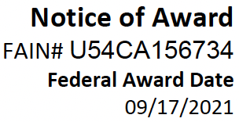
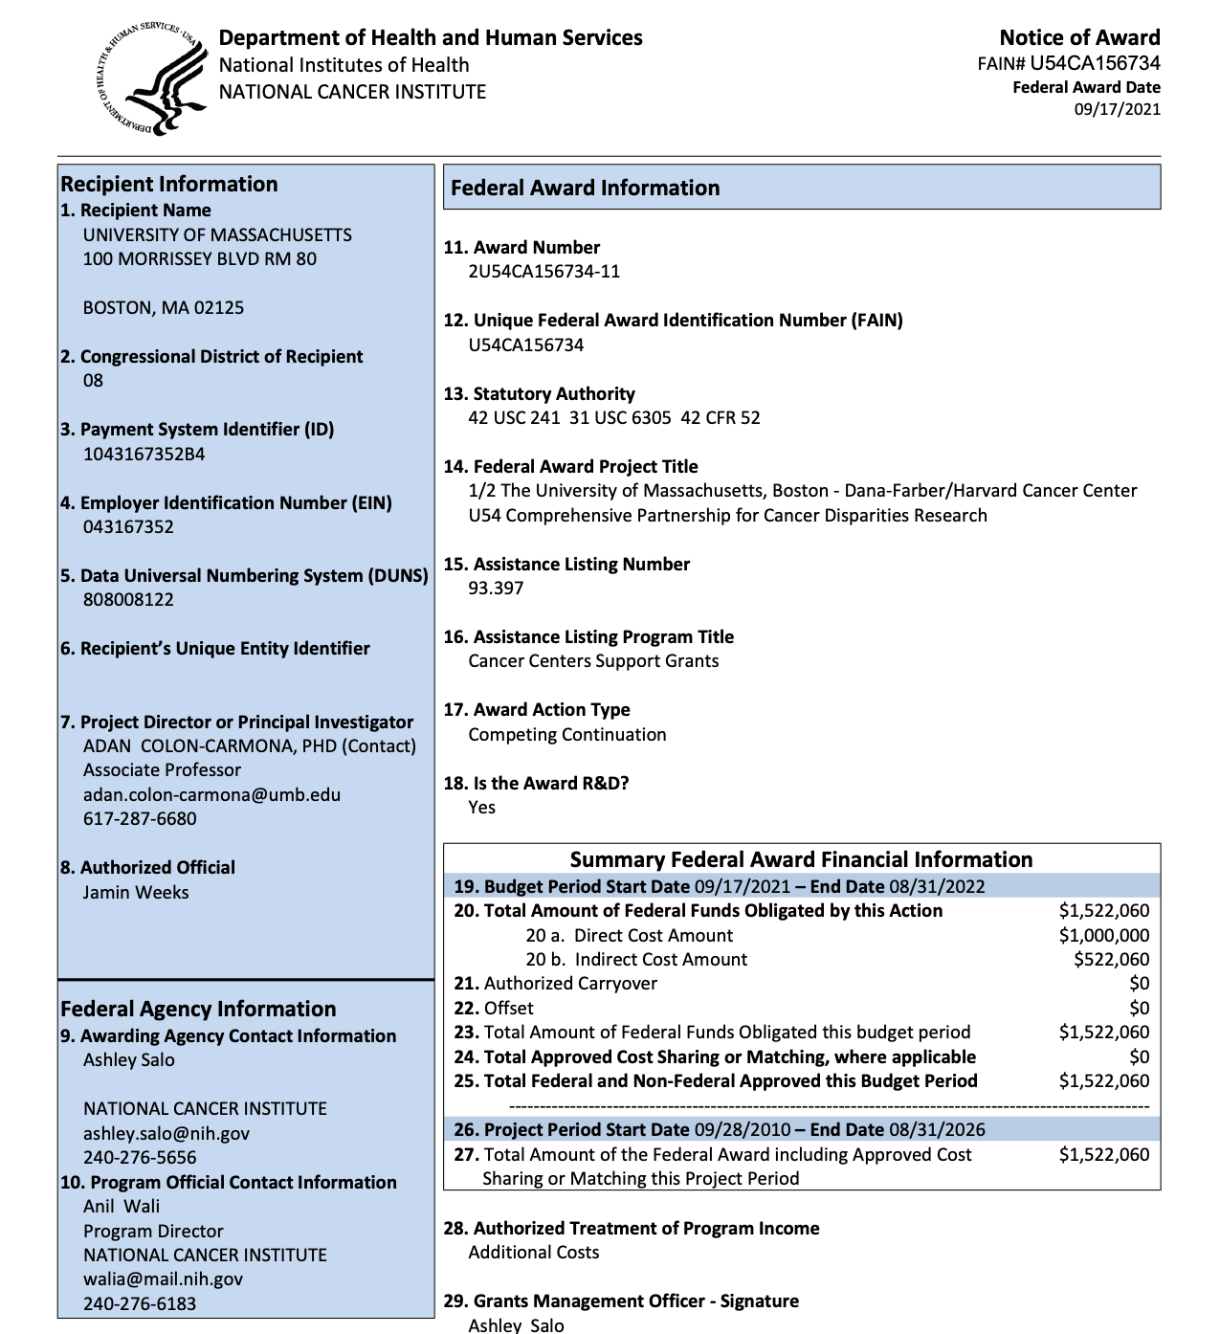
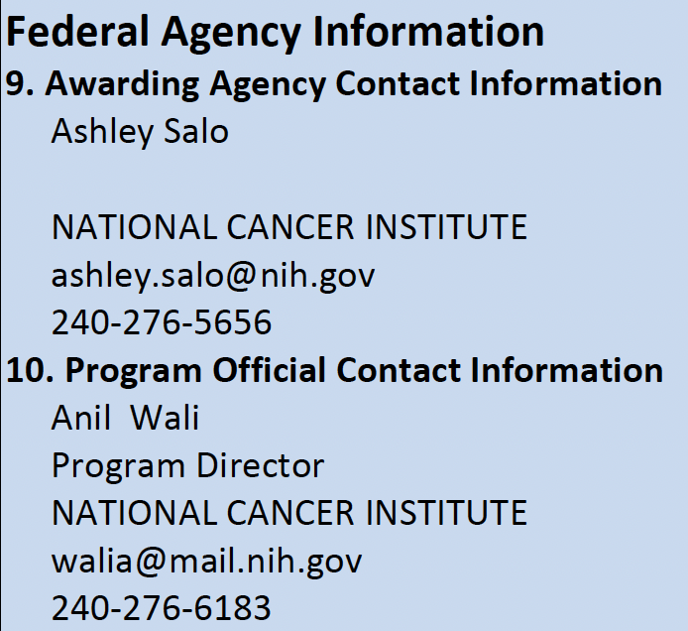
Ashley is your
administrative contact.
Please always contact ORSP first as we may be able to provide answers, information, or facilitate communication.
Anil is your program/
project contact.

Slide 30
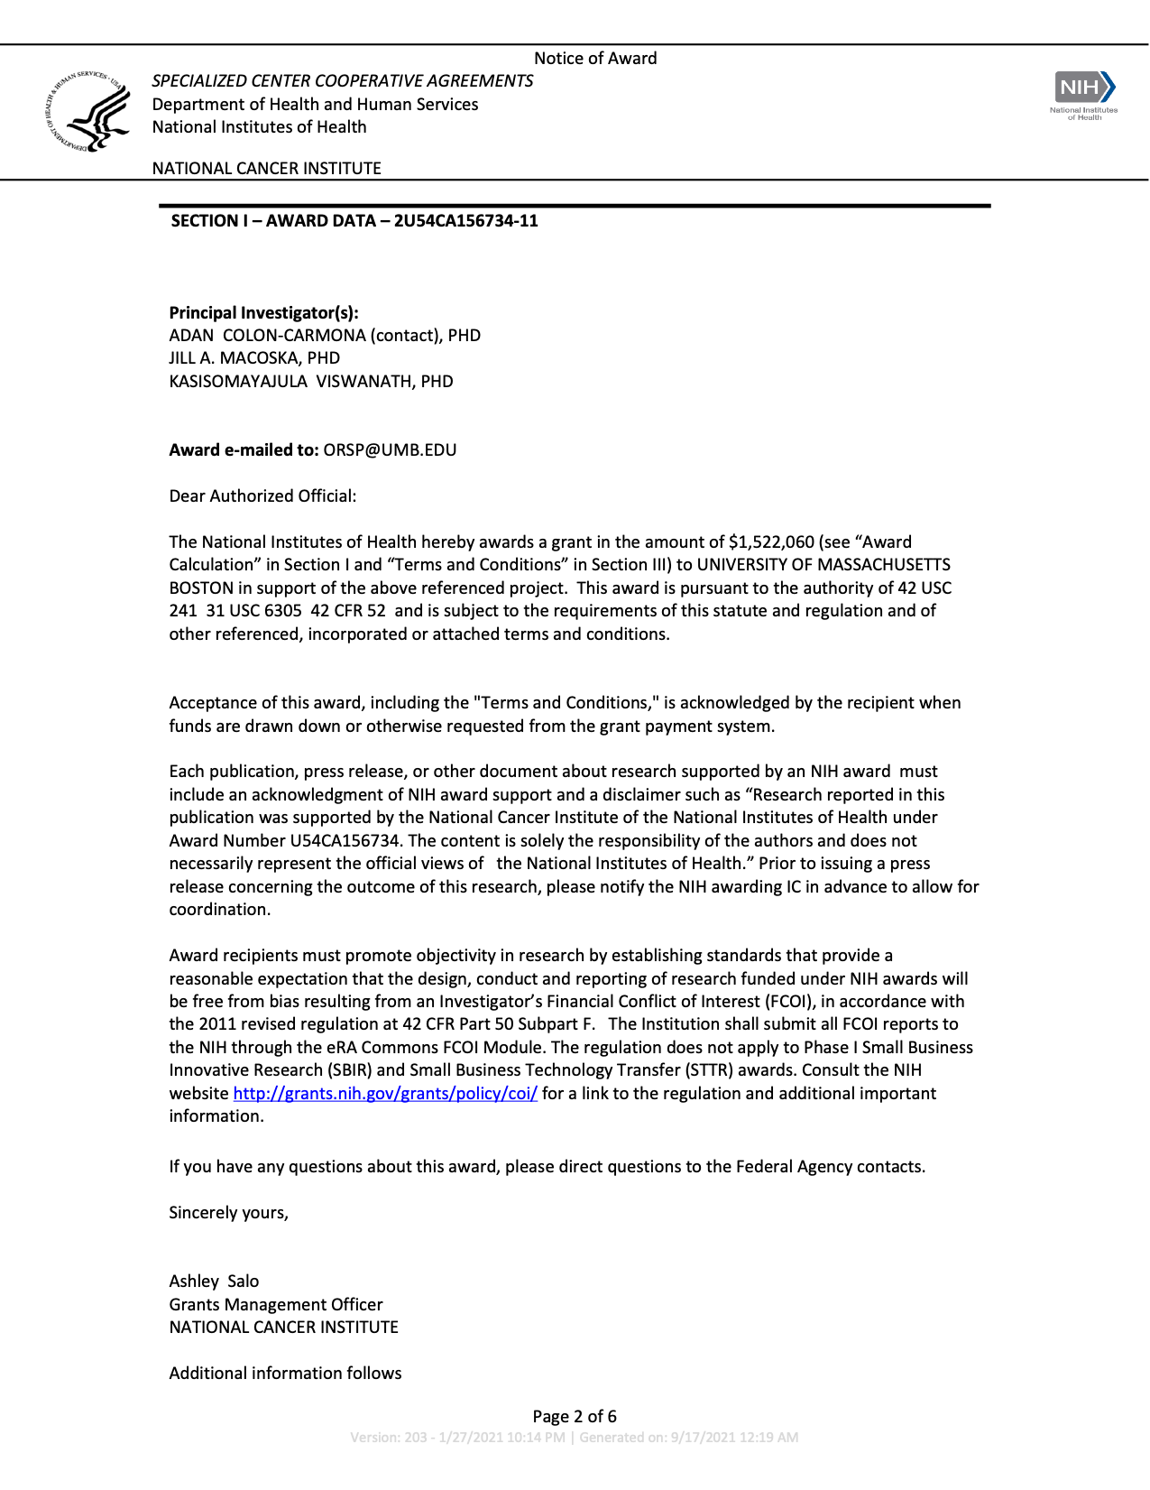
Adan and Jill are the key personnel on this award. If there are changes to their time, involvement, etc., please contact ORSP immediately.
Notes:
Becky and Tracey: Add/revise comments bubbles

Slide 31
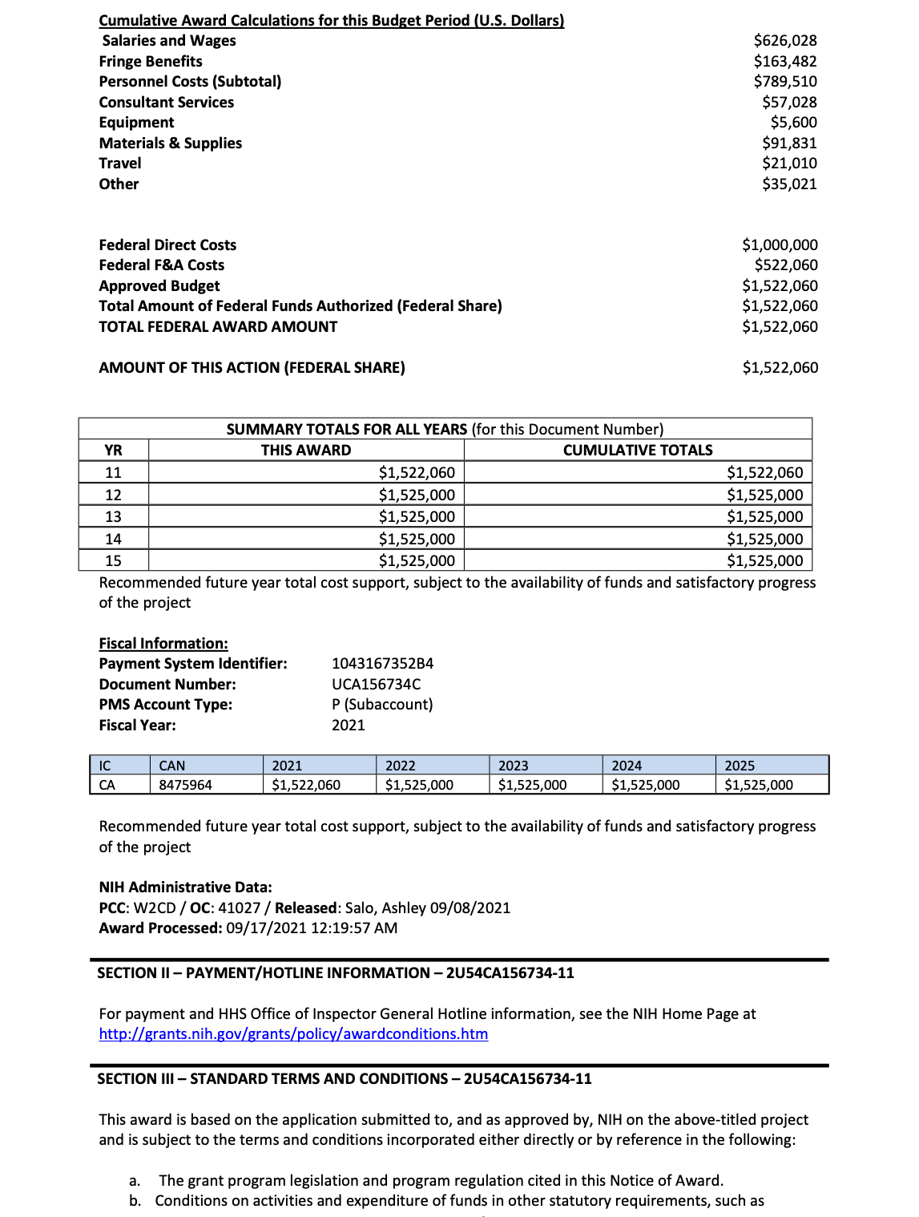
NIH's Expanded Authorities allow for some limited changes to the budget without prior approval, giving some flexibility while also keeping in mind that this is the budget that both parties agreed upon.
Submission of timely and thorough progress reports will help to ensure future funding.
Section III Terms & Conditions referenced on page 2. Please be familiar with them.
Notes:
Becky and Tracey: Add/revise comments bubbles

Slide 32
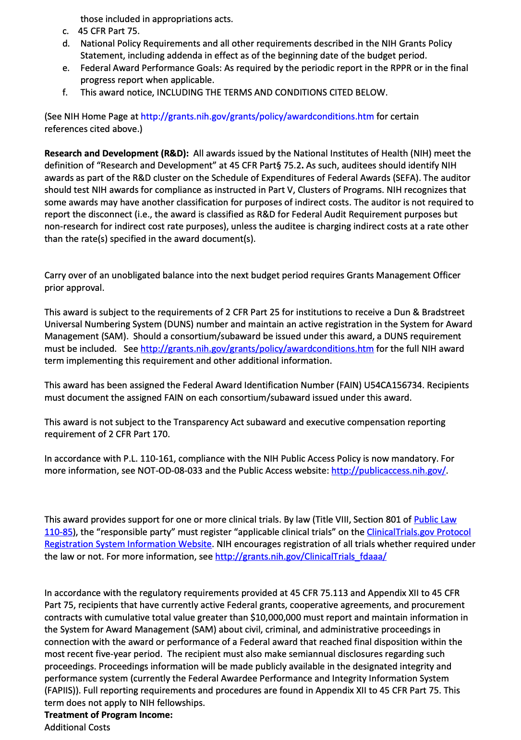
Expenses for each year need to be finalized in a timely fashion.
Likely setup of a separate PS award.
Published articles funded by this grant must be reported to NIH for inclusion in PubMed Central (PMC).
Notes:
Becky and Tracey: Add/revise comments bubbles

Slide 33
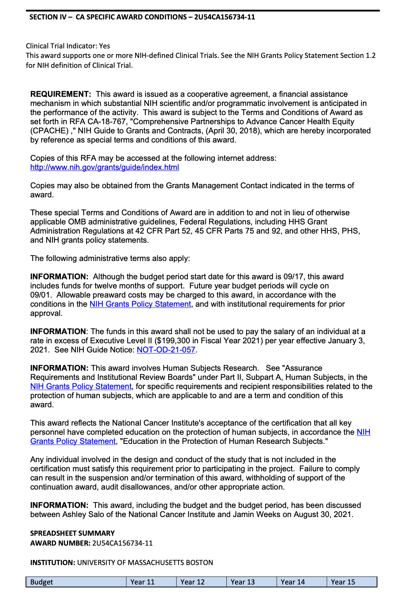
Certification of IRB approval of the project's proposed use of human subjects; verification of IACUC approval of the project's proposed use of live vertebrate animals; and evidence of compliance with the education in the protection of human research participants requirement. Other program-specific information may also be requested using this procedure.
Notes:
Becky and Tracey: Add/revise comments bubbles

Slide 34
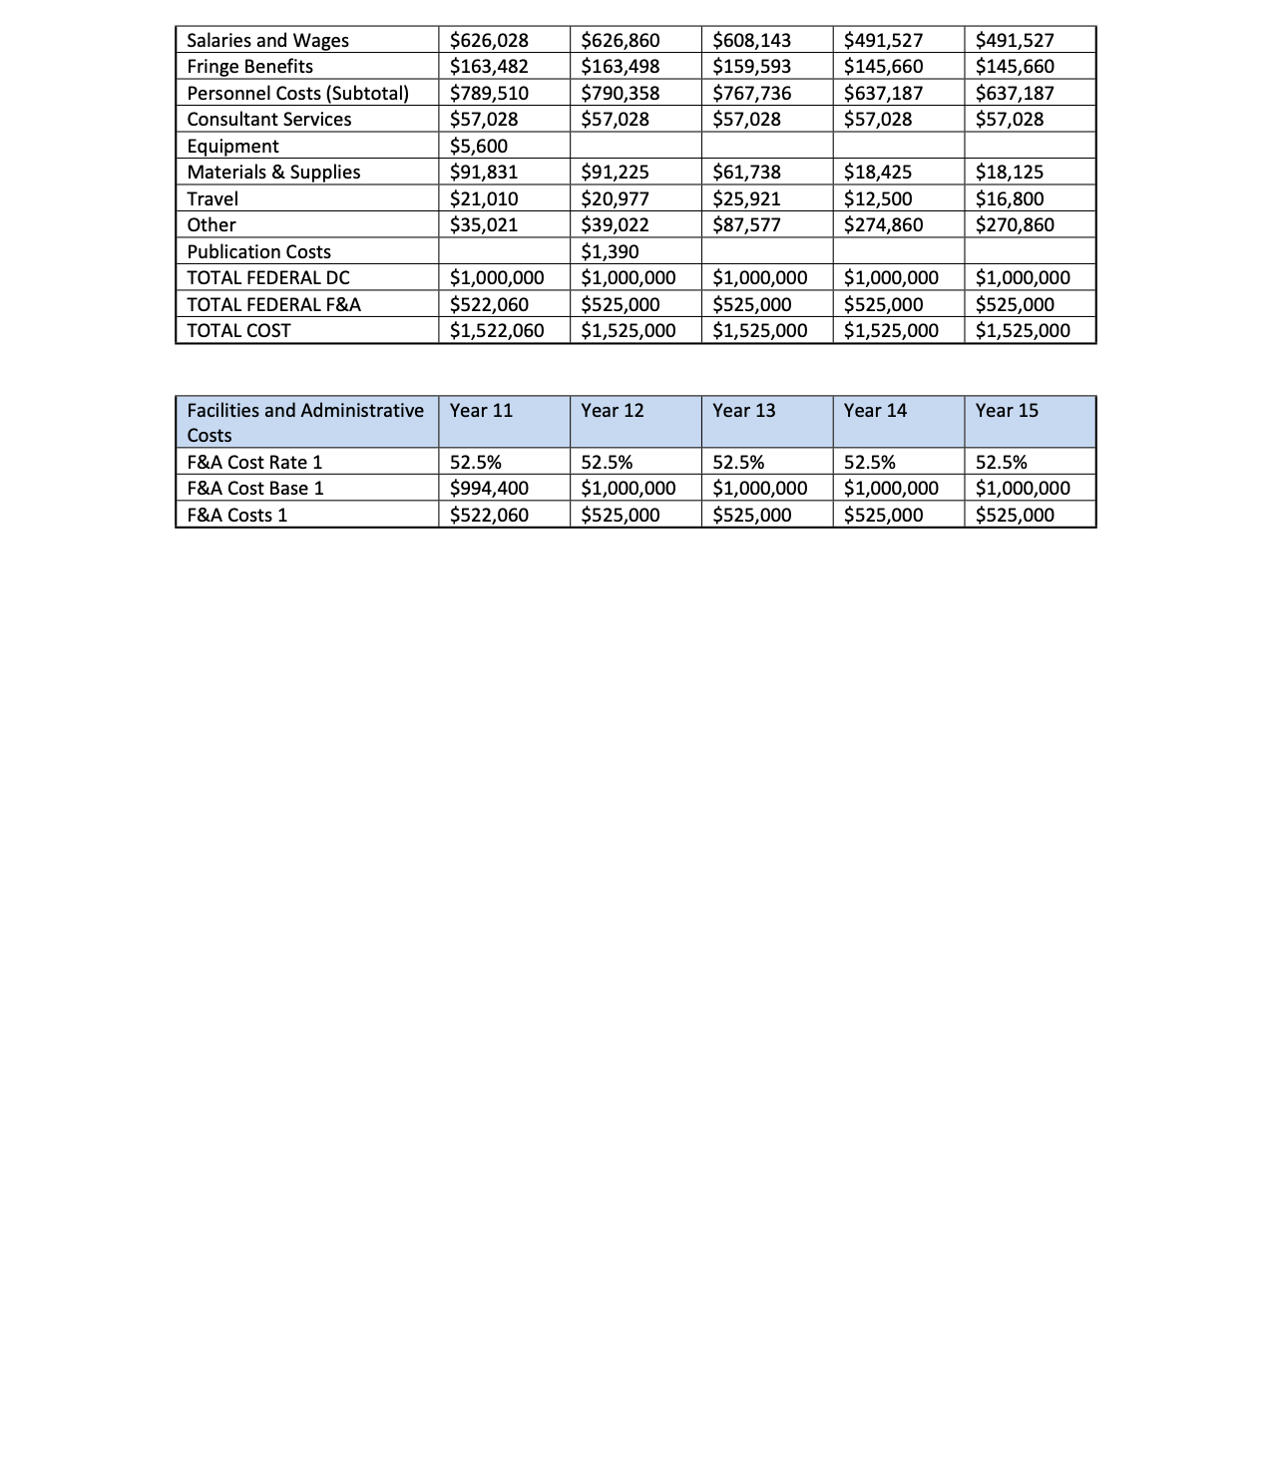
Notes:
Becky Add/revise comments bubbles

Slide 35
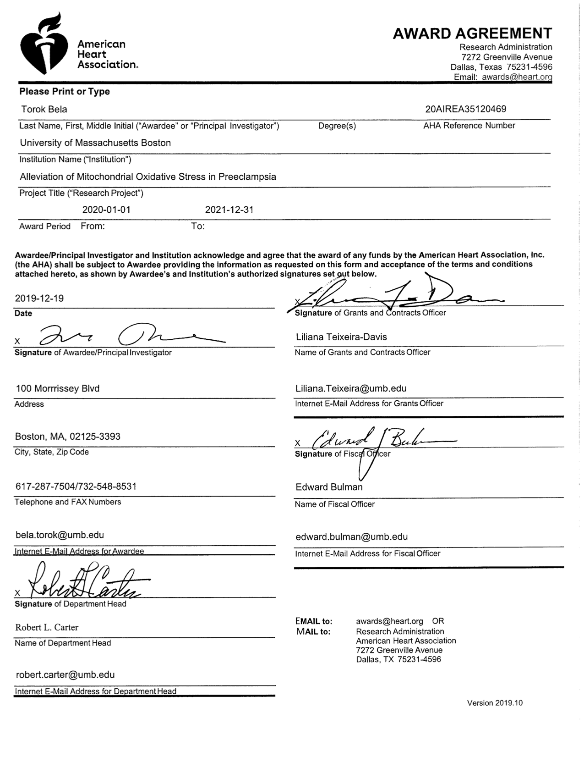
Sponsor contact information
Award period of performance.
Notes:
Tracey and Becky add comments to bubbles

Slide 36
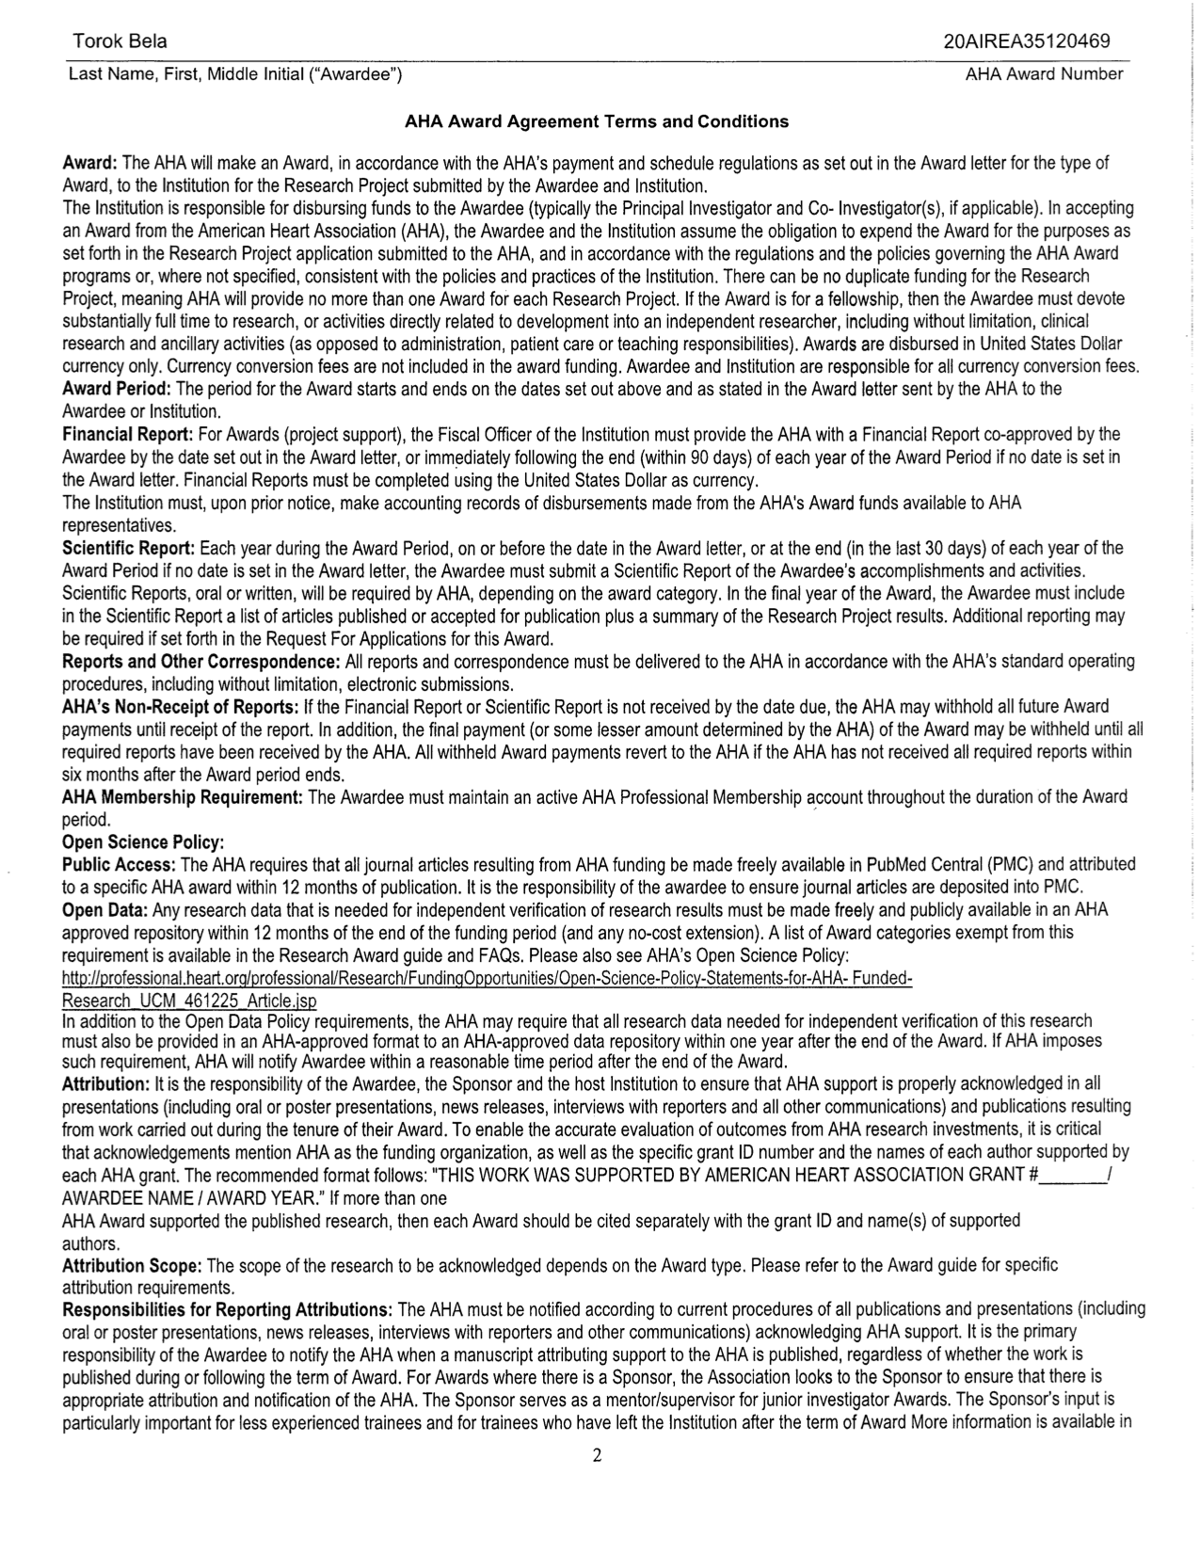
All expenses must be for completing the approved work.
Fellows are expected to give their full time to their AHA award. A buyout will need to be processed.
Late reports may result in nonpayment, and department funded write-offs.
Notes:
Tracey and Becky add comments to bubbles

Slide 37
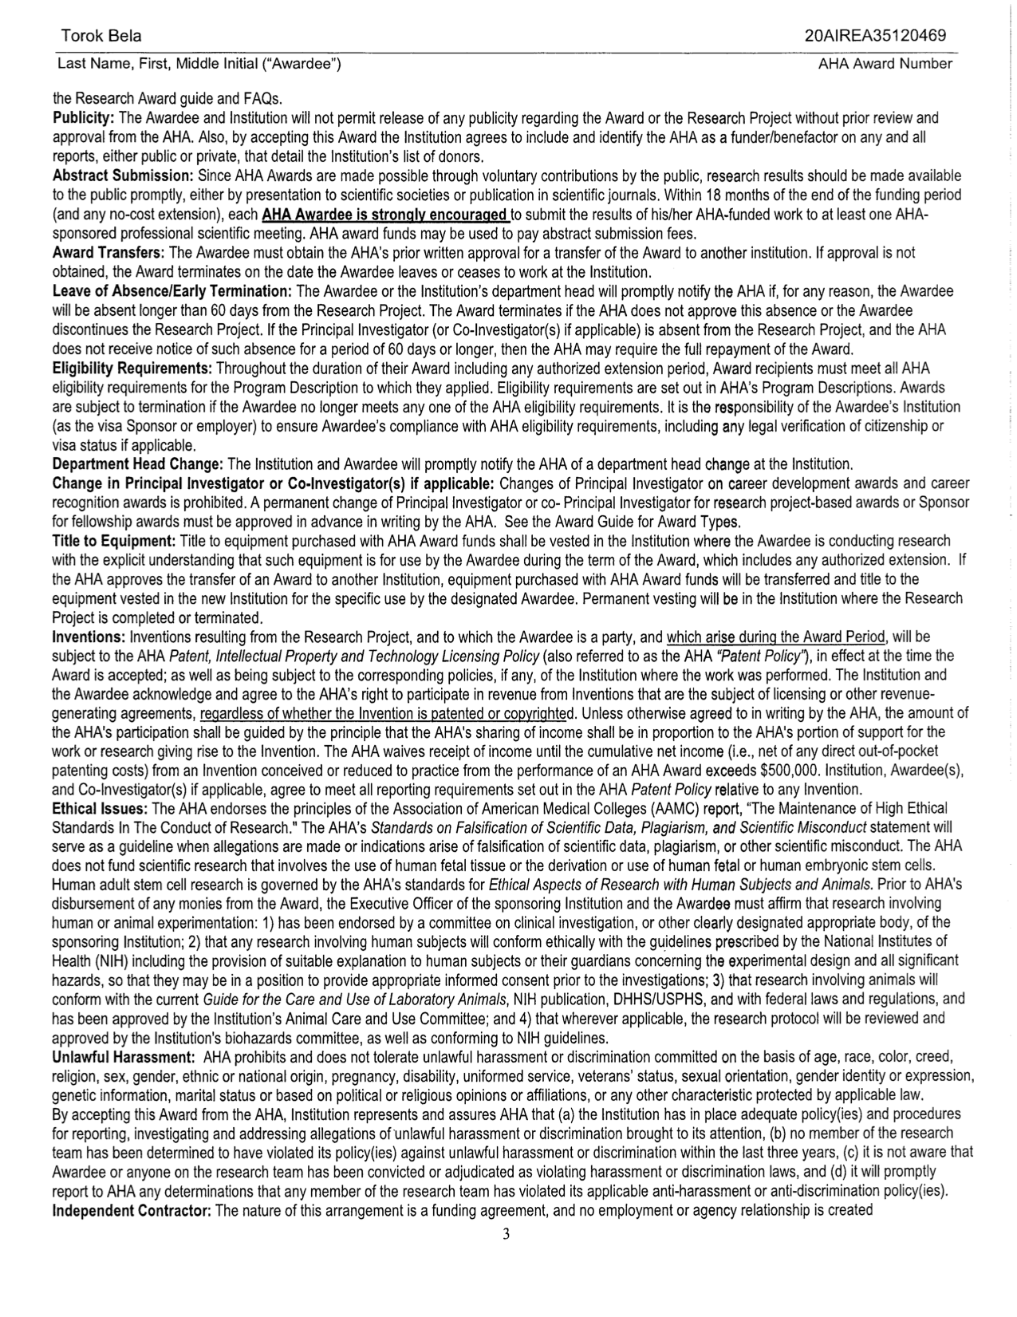
Sponsor wants you to share findings. They will pay for the fees.
PI must get preapproval for leave of absence or AHA may terminate the award and require all funds to be returned. Department will need to fund any expenses.
PI change requires preapproval
Equipment moves with the award.
AHA revenue rights to inventions.
Notes:
Tracey and Becky add comments to bubbles

Slide 38
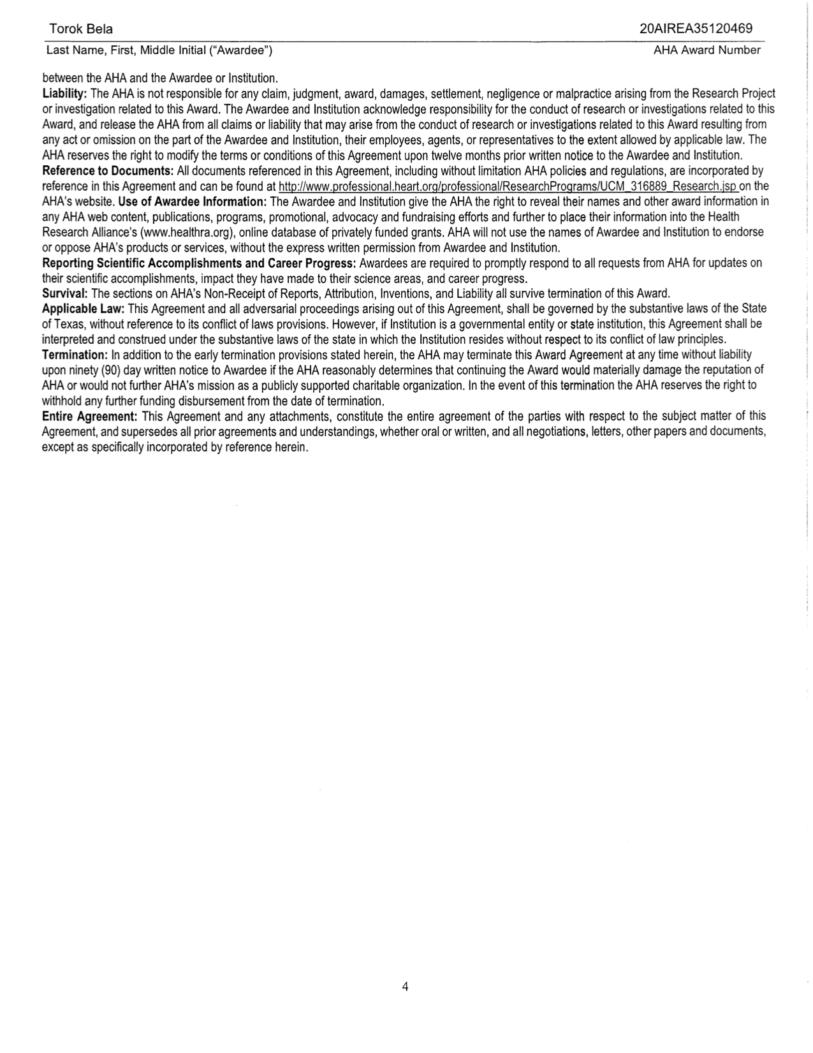
Easy reference point for terms & conditions.
Notes:
Tracey and Becky add comments to bubbles

Slide 39
Common Pitfalls
ISSUE: Communication: Contacting the wrong POC for the wrong issue
Delays: Could affect the timely response and resolutions to issues
Red Flags: Add scrutiny from sponsors and inadvertent red flags to sponsors
Misinformation: Conflicting or inaccurate answers
Example: Asking a Sponsor’s Program Official if it’s OK to rebudget and hire a graduate student instead of a post-doc which was originally proposed
Notes:
Tracey add poll. “Which Award Point of Contact should field this question (PI, ORSP, Sponsor?)”. “Where could you find this information (HR, Award T&C, OMB Guidelines)”
Added questions – feel free to edit. Let me know if you want to add more.

Slide 40
Common Pitfalls
ISSUE: Assuming all awards from the same sponsor have the same T&C’s
Delays: Delays in project plan/timeline, sponsor requests and notification
Red Flags: Lack of due diligence in reviewing the awards T&C’s or being aware of updated and current P&Ps
Misinformation: Award management strategy that is not consistent with award T&C’s.
Example: Assuming all federal awards allow automatic carryforward from one budget period to the next.
Notes:
Speaker: Shala

Slide 41
Common Pitfalls
ISSUE: Timely posting of expenses
Delays: Delays in award invoicing, financial reporting, and closeout
Red Flags: Breakdown of internal controls and increased audit risk (Single Audit & Sponsor Audit)
Misinformation: Award management not consistent with sponsor requirements or generally accepted accounting principles
Example: Significant gaps in spending or incomplete final expenses.

Slide 42
Common Pitfalls
ISSUE: Assuming all re-budgets (and related expenses) between approved budget categories are always allowable.
Delays: Rejected or Delayed award invoicing, financial reporting, and closeout
Red Flags: Breakdown of internal controls and increased audit risk (Single Audit & Sponsor Audit)
Misinformation: Award management not consistent with sponsor requirements
Example: Overspending restricted budget categories which creates unallowable expenses because prior approval is required.
Notes:
Examples include PSC, travel and capital equipment

Slide 43
Common Pitfalls
Research Compliance and Integrity
ISSUE: IRB/IACUC Pending, Certification of HS Training, updated disclosures
Delays: Delays in project plan/timeline.
Red Flags: Breakdown regulatory requirements, lack of training.
Misinformation: Could result in publication and research integrity issues
Example: Expired or DRAFT protocol. Keep in mind most compliance committees only meet once a month.
Notes:
Tracey Add Example

Slide 44
Part III: Project Kick-off ORSP Project Information Notification (PIN)Report Roles and Responsibilities
Notes:
Speaker: Postaward

Slide 45
ORSP Project Information Notification (PIN) Report
What is a PIN
A summary of important award attributes
How is a PIN generated
Generated by ORSP Post Award from PeopleSoft (UMGM7014)
When is a PIN distributed and to who is it sent
Upon completion of initial award set-up and at modifications
PI, Department Grant Admin, ORSP PreAward
Review sample PIN
Notes:
Speaker: Postaward
Becky add animation

Slide 46
Notes:
Speaker: Postaward

Slide 47
Notes:
Speaker: Postaward

Slide 48
Roles and Responsibilities
Award Points of Contact
PI and Project team becomes Contact PI and Key Personnel
Program announcement Points of Contact become Sponsor POCs (i.e. program officials, grants management specialist etc.)
PreAward, Post-Award and Compliance Managers are Administrative, Financial, Compliance POCs
Notes:
Speaker: Shala

Slide 49
Roles and Responsibilities
Areas of Responsibilities
Project/Program
PI, Collaborators, Key-Personnel
Key Support from Dept., Unit
Award Management
PI, Dept. Unit
Key Support from ORSP, University Business Offices
Research Administration
ORSP, Dept., Unit
Key Support from PI and Key-Personnel
Notes:
Speaker: Shala

Slide 50
Roles and Responsibilities
UMB Research Administration
Roles and Responsibilities Matrix
Notes:
Speaker: Becky

Slide 51
Questions?
Notes:
Speaker: Shala

Slide 52
Resources
CRA Certification-Research Administrators Cert. Council
Cornell Law
ECFR
ORSP Contact by Department
ORSP Forms
ORSP PI Toolkit
ORSP Research Policies A-Z
Procurement Training Resources
Office of Research Integrity
NIH Conflict of Interest
NSF Data Management & Data Sharing
UMB Scholarworks
Notes:
Speaker Shala

Slide 53
Next Time……
Next G.R.A.N.T Forum will continue discussion on Award Kick-off following topic:
Award Budget, Activities and Transactions
Notes:
Shala Add Content

