Slide 1
UM-Plan: Strategic Financial Planning & Analysis Tool
Saving Reports and Plan Files to Excel for sharing/printing
Last update: November 2022

Slide 2
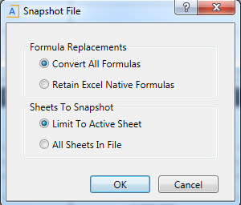
Snapshot
When saving as an excel file the first step you must take is to snapshot
In the next prompt you will be able to select formula replacements and which sheets to export. Select ‘convert all formulas’ to change all numbers to values in the exported Excel spreadsheet, select ‘retain excel native formulas’ to keep all formulas from the plan files in the exported excel spreadsheet. Select ‘limit to active sheet’ if you only want to export the selected sheet or ‘all sheets in file’ to export all sheets in the plan file or report.

Slide 3
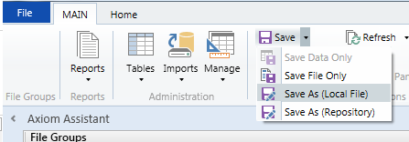
Saving as local file (MAC users skip)
Once a snapshot is taken a new tab in UM-Plan will open
With the new tab selected select save as local file from the save dropdown
Select the location you would like to save the excel file, from there you can email and/or print as you would any other excel file.

Slide 4
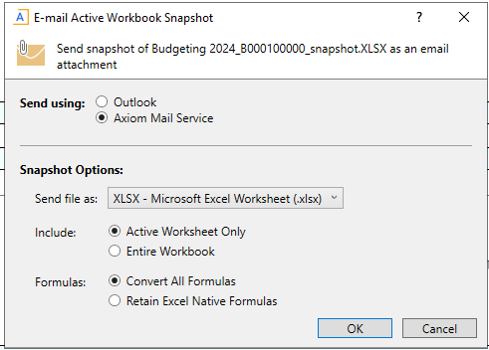
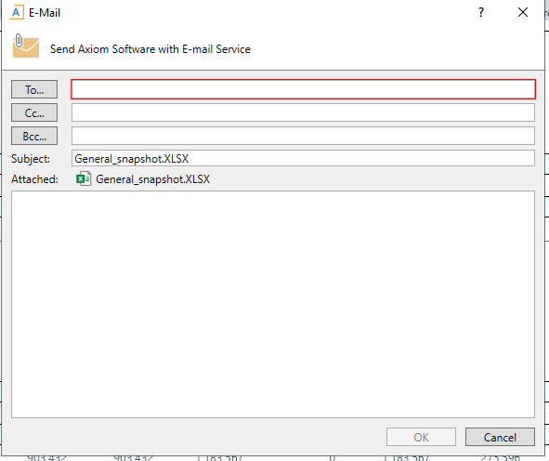
Email file to your UMB email (MAC users)
Once a snapshot is taken a new tab in UM-Plan will open
With the new tab selected select email from the UMPLAN MAIN menu
Select Axiom Mail Service in the Send Using section, refer to the first slide when choosing the selections in the “include” and “formula” section. Once you click ok you will get a prompt that you can edit the actual email that will be sent and who you can address it to.

