Slide 1
Behavior Management and De-escalation strategies
2025

Slide 2
Be proactive
Warnings
We have two more minutes
Go over the schedule in the morning
Breaks
Incentives
First/then
This can be used for incentives or just to remind campers of what's coming
First, we have field - Then, we have snack
Reminders of expectations
Reminders of choices

Slide 3
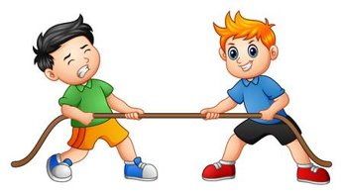
Battles for Control
DON'T PICK UP THE ROPE
Escalated campers will seek to control the situation
Be aware and don’t fall into a power struggle
Give controlled choices whenever possible
Do you want to sit or stand
Do you want to walk with me or so-and-so
Do you want the red or the blue
Do you want to stomp or clap

Slide 4
Work as a Team
Don't take behaviors personally
It's very rarely about you
If you were the one to upset the camper, you're likely not the person who will de-escalate them
Know when to tag in/out and when to call for help
Be mindful of your own frustration level
The same person should not always be responding to behavior
A camper may respond to one person better than others and that's ok

Slide 5
You're Reaction Matters
WHAT you say:
Say what you mean and mean what you say
Stay away from sarcasm!
Be clear, concise (the less words the better) and consistent
Focus on desired behavior - avoid "don’t"
Walk please
Indoor voice please
Answer information seeking questions
Be respectful
HOW you say it:
Tone
There are times where it's ok to be firm, however, make sure you're not condescending, or impatient
Volume
Be clear while avoiding yelling
Often speaking softer will get a camper's attention better than yelling
Cadence
Try to keep your voice calm
What your BODY is saying:
Avoid crossing your arms
Safety stance
Be aware of your facial expressions
Move slowly
Do not attempt to touch the camper even in a friendly manor.
This can be seen as threatening to some even if you don’t mean it to be

Slide 6
If you come across another counselor working with a dis-regulated camper
Don't stare at the camper – when there is an audience behaviors tend to get worse
Ask if they need help or want help called – respect the answer
Direct other campers away and keep their attention off of the situation as best as you can
Reassure them the camper is safe and is being helped

Slide 7
Things to remember:
It's better to be proactive than reactive
Follow through 100% of the time
Never be alone with a camper
Know when to tag in/out
Work as a team
Be mindful of your own actions
DON'T TAKE IT PERSONALLY – it's not about you
DON'T PICK UP THE ROPE

