Slide 1
CAMP SHRIVER FUNDRAISING 2025

Slide 2
Expenses
Staff – at least a 1:4 counselor-to-camper ratio
Breakfast & Lunch
Transportation
Camp Shriver Gear
Supplies/Materials
Total in 2024 = $358K for 130 campers
$2,750 per camper for 4 weeks of summer, or
$17,900 per day

Slide 3
Thank You Sponsors!
The Agnes M. Lindsay Trust
The John Alden Trust
Lend a Hand Society

Slide 4
You Can Help!
Site Visits
Be your fantastic charming selves and talk with our guests!

Slide 5
You Can Help!
Site Visits
Be your fantastic charming selves and talk with our guests!
Share Your Best Camper Stories
Have you seen a change in a camper? Saw a moment that exemplifies our mission?

Slide 6
You Can Help!
Site Visits
Be your fantastic charming selves and talk with our guests!
Share Your Best Camper Stories
Have you seen a change in a camper? Saw a moment that exemplifies our mission?
Introduce us to Someone
Do you/your family know a person or business with the capacity to give to Camp Shriver?

Slide 7
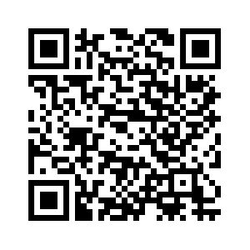
Join us! Friends of Camp Shriver

Slide 8
Join us! Friends of Camp Shriver
Raise $150 and run for free!
Run, Walk or Roll with us in Natick or
Virtually, from wherever you are!
…tshirts, swag, etc., included!
Date is TBA

Slide 9
Join us! Friends of Camp Shriver
Run with Us! Or Tell Your Friends to Run with Us!
World Marathon Majors!
Boston Marathon
TCS NYC Marathon
Tokyo Marathon
Berlin Marathon
Plus…
Marine Corp Marathon
Dublin Marathon
Miami Marathon
Rome Relay
Napa Valley Marathon
Paris Marathon

Slide 10
Text Your Name to the Camp Shriver Phone!
(857)271-6010
Thank you!

