Slide 1
Camp Shriver
2025

Slide 2
Welcome!
We are excited to have you on board for Camp 2025! Camp is a special place that only works because of the amazing staff we have. We’re going to have a fun filled summer!
In this guide you’ll find:
The expectations for you as a staff member
Ideas of how to include and engage every camper
Behavior management strategies
Conflict resolution strategies
Phone policy
Important phone numbers

Slide 3
Expectations
Whether you’re a camper turned counselor, brand new to camp or a long time returner, it’s better to know what is expected before we begin rather than teetering in the unknown.
You don’t know what you don’t know right?
To put everyone at ease, to get everyone on the same page, and to hopefully help answer some questions we’ve broken down our day to show what it entails.
Remember the best thing you can do is lead by example!

Slide 4
The Morning Bus Ride
If you ride the bus you’re one of the first faces kids will see and you could set the tone for their day.
Lead monitors will check campers in as they arrive on camp brain
If you’re not a lead monitor you’re still important! Say good morning to every camper.
Set boundaries for where they can play/wait for the bus.
Play/talk with the campers while waiting and on the bus.
Once on the bus spread out! It’s important that the counselors are spread out on the bus. This is not a time to put your headphones on and get lost in your phone.
Our job on the bus is to make sure our campers are safe but that doesn’t mean it has to be boring.
Lead monitors: once everyone is on the bus do a final count to make sure you have everyone before leaving

Slide 5
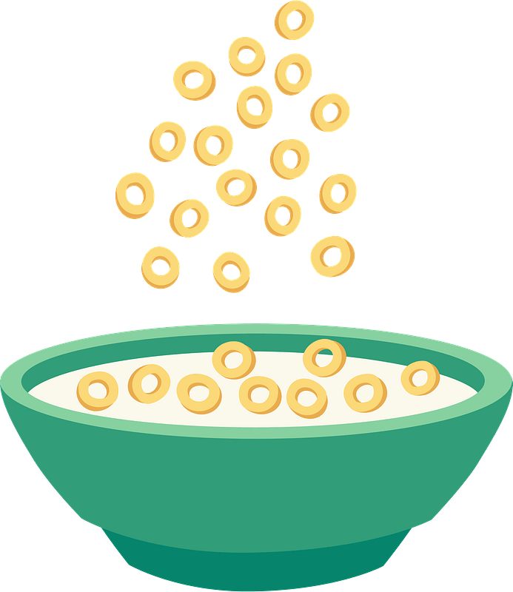
Arrival/Breakfast
When you first arrive at Camp:
Put your stuff down and check in with your team.
Say good morning to your fellow counselors and campers that are already there.
Don’t forget to get breakfast!
When you go up for breakfast encourage campers who haven’t eaten yet to get breakfast too - many will want to play but when the whistle is blown breakfast is over
If you finish breakfast before the whistle go play! Enjoy the morning sun, join a game, look for groups of campers without a counselor, look for campers who are alone, encourage them to join you

Slide 6
Gym
Encourage all campers to get accustomed to the daily routine and get into the groove.
Listen to the instructions each day and assist the campers in following directions and getting started.
Join in on the fun! The campers look up to you and get excited when you participate in the activities and games.
During gym, campers like to grab water or use the restroom. Your help is greatly appreciated in accompanying the kids to the water fountain or restroom.
Encourage the campers to help clean up the equipment at the end of each gym session - the gym should look the same as when your team entered.

Slide 7
Field
Once you are familiar with daily routines (i.e., warm up lap followed by circling up to do stretching), don't wait for the coach to give out those directions -- show leadership
Listen to activity directions so that you can also answer camper questions during the activity
Attend to camper behavior so it doesn't just fall on the coach
Encourage participation and participate yourself, but remember to make the games about the kids
Encourage all campers to help clean up before leaving

Slide 8
Art
Spread out at the tables! There shouldn’t be more than 2 counselors at a table.
Offer to help pass out materials
Help campers with their projects as needed - Not everyone will choose to do the project of the day and that’s ok but the coach is only one person so help is appreciated!
Do an activity! Try the activity of the day, draw with a camper, make a bracelet, just do something. If you’re sitting doing nothing that’s what the campers will want to do too
Encourage ALL campers to help clean before leaving or going to the bathroom. The room should look like the same as when your team entered.

Slide 9
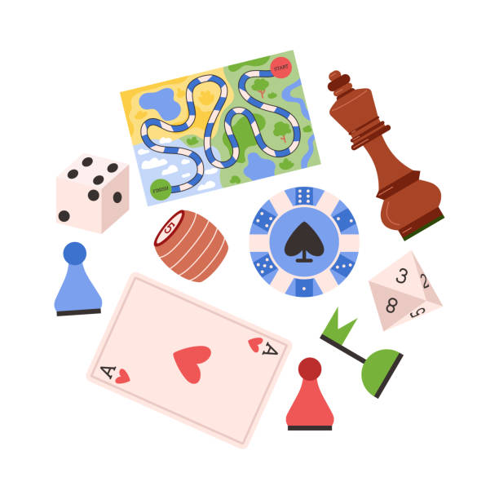
Game Room
Play Fair
Be gracious winning and losing - No sore winners and no sore losers
Keep the chairs where they are - No wheeling chairs around the room
Counselors should be spread out
Clean up before leaving - Leave how you found it
Kids can never be alone - have a counselor go with anyone going to the bathroom

Slide 10
Swimming
Get changed as quickly as possible and then help encourage campers to do the same.
Walk to the Y with one person in the front, one in the back and then others are spread throughout the middle.
Once in the pool have one or two people help pass out life jackets and goggles and then GET IN THE WATER
Try not to complain about the water. If you complain the kids will too.
Encourage campers to walk/swim away from the wall. Most of them will be able to stand as it’s only a few feet deep

Slide 11
Courts
Don’t just sit or stand around, do the activities with the kid.
The courts are HOT so it matters even more that you aren’t just sitting in what little shade is there and you are up playing
If you see a kid is struggling, help them back into the activity.
If you seem disinterested in an activity, that translates to the kids, have fun, be active.
If you’re playing a game with the kids, let them win! Don’t make it so obvious, but let them win. This isn’t about you, it’s about the kids. They will be so excited to tell people they beat their counselor, it can make their day, or their week.

Slide 12
Transitions
When moving from activity to activity it’s important to make sure you have all your campers on your team. The best way to do this is to line them up. Different ways to line your campers up can include:
Birthday
Alphabetically (forward or backwards)
Ask questions, for example, If you have an older brother, line up, older sister, younger sister, only child, etc.
Color
Pick a line leader (Pick a new leader every time)
Count your campers before leaving to make sure you have everyone.
As you move make sure counselors are spread throughout the line. This helps prevent conflict and losing anyone while moving.
Make sure the team thanks the coach your leaving before moving out!

Slide 13
Water/Bathrooms/Snack
Bathrooms/Water:
If you need to get water or go to the bathroom or a camper asks to go, ask the rest of the team if anyone else needs to go.
Before leaving make sure your other counselors know how many you have with you.
The best time to go is at the end of an activity but these can be used as breaks for some campers as well.
At snack time:
Let campers pick snack first
Everyone gets a squirt of sanitizer
Remind campers to say please and thank you
Encourage campers to use the bathroom and fill water bottles
Remind campers this is a time to sit, cool off, and eat

Slide 14
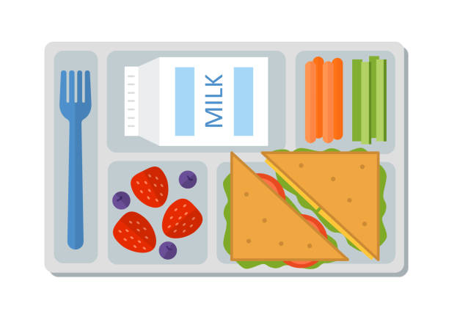
Lunch
Campers will be called up to get lunch by teams. This is where we can teach campers patience, to wait their turn in line, healthy choices and manners.
Remind campers to sit quietly to be called up
If anyone brought a lunch from home they should wait until their team is called to open their lunchbox and start eating
All campers should get lunch before counselors
Campers and counselors eat with their teams
No one gets seconds until everyone has had some. If there is enough Mark will call “Seconds!”
Please let campers go first for seconds

Slide 15
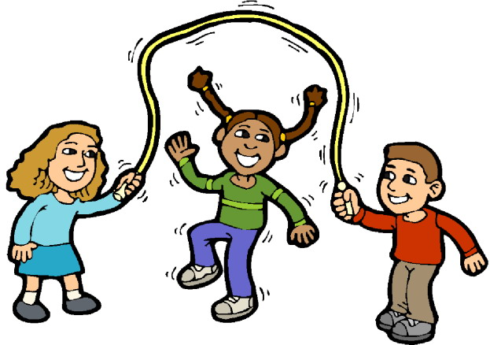
Free Time
After you finish eating with your team please go play!
This is the least structured time for our campers so this is the time that problems tend to arise the most. This can best be avoided if counselors are with groups of campers.
Just like after breakfast, counselors should join a game, look for groups of campers without a counselor, look for campers who are alone, encourage them to join you and other campers.
This is also a great time for bathroom runs.

Slide 16
Mark’s Announcements
Every morning after breakfast and every afternoon after free time Mark does announcements. This includes the theme of the week, shout outs, what lunch is, any changes to the schedule and any other important information.
We expect campers to listen quietly to Mark. The best things you can do is:
Remind campers to sit and listen
Remind campers to turn their voices off
Remind campers this is not a time for bathrooms (except for emergencies) or toys

Slide 17
Afternoon Bus/Dismissals
If you ride the bus you’re also one of the last faces campers will see and last experience of the day.
Lead Monitors: Before leaving Camp make sure someone counts the campers (before and after getting on the bus)
Once on the bus spread out! It’s important that the counselors are spread out on the bus. This is not a time to put your headphones on and get lost in your phone
Our job on the bus is to make sure our campers are safe but that doesn’t mean it has to be boring.
Lead monitors will check campers out as their people arrive on their attendance.
Say goodbye to the campers as they leave..
Set boundaries for where they can play/wait for their people
Play/talk with the campers while waiting

Slide 18
Phone Policy
The campers are not allowed to use their phone (or other technology) while at camp we expect the same for all of the counselors and staff
If there’s an emergency or reason why you need your phone one day please let one of us know
If you’re on your phone you are not fully keyed into the campers. Not only is this not safe but the campers notice.
A lot of our campers look forward to making connections with our staff (you’re often the best part of their day) and that can’t happen if you’re on your phone all day.
After attendance your phone should be put away.

Slide 19
Getting Campers Involved and Engaged
Engagement looks different for each camper. Our goal is to get every camper involved in the activity.
This can look like:
Playing/doing the game/activity
Keeping score
Cheering on the team/player
Doing the activity side by side with a counselor
Doing one part of the activity (like kicking but not running)
Taking breaks after a set amount of time
Remember campers are more likely to do it if all the counselors are doing it. They look to you!

Slide 20
Behavior Management
Be aware of your own body language, facial expression, volume and tone of voice
Genuine praise - stay away from “good job” be specific “Thanks for using your words!”
Be clear and concise with what you are expecting
Be consistent
Follow through 100% of the time - No empty threats or promises
DON’T PICK UP THE ROPE - Don’t engage in a power struggle
Know when to tag in another counselor or call for help
If you were part of why a camper is upset you will rarely be the one to de-escalate them

Slide 21
Camper Conflict
Camper conflict will arise at some point or another this summer so strategies to try are:
Recognize and validate feelings (I see you’re frustrated)
Listen to both sides and have the other peer listen too
Come up with a plan together (i.e. timers, turn taking, rock paper scissors, seeking a counselor, using our words, ect)
Praise and acknowledge when you see plan being done

Slide 22
Have Fun!
Most importantly HAVE FUN!
Enjoy the games and activities, get into it, be silly, just be you!
This can be one of the most fun, exhausting and rewarding jobs if you let it be.

Slide 23
Important Phone Numbers
Camp Shriver Phone
857-271-6010
Mark
617-224-7005
Danna
781-710-2683
Cassie
781-964-3262
Nurse Kailyn
774-571-5200

