Slide 1
MA Summer Food Service Program MA Dept of Ed
At Camp Shriver 2025

Slide 2
Why?
Because there WILL be a surprise visit from the MA Dept Of Education this summer! . . . Or will there?? THERE WILL BE!!!
It is very important to demonstrate:
accurate records, especially meal counts
that Camp Shriver is complying with all MA DOE policies
that you understand your role in these policies

Slide 3
Purpose & General Program info
Purpose: to provide food service to children from at-need areas during periods when area schools are closed for vacation… over 60% of campers live in low-income neighborhoods
Site eligibility (location)
Importance of accurate records and recordkeeping requirements, especially meal counts
Importance of organized site activity i.e. Camp Shriver’s daily schedule

Slide 4
Meals Provided by…. UMass Amherst
Sodexo
Serving Breakfast (8:30) and Lunch (1:00)
Delivery occurs at 8:25 and 12:55
Mark will be in touch with UMass Amherst with updated attendance information to adjust number of meals, if needed
UMass Amherst handles appropriately storing meals (very important)
Who to contact about problems: Mark

Slide 5
Meal Pattern Requirements: Offer Vs Serve, BREAKFAST
Sodexo
We offer 4 Items from 3 components (milk, grain, fruit, meat alternative)
Milk (8 fl oz) Juice or Fruit (1/2 cup)
Cereal or Muffin (1 serving, ¾ cup) Yogurt (meat alternative)
CAMPERS MUST TAKE 3!!

Slide 6
Meal Pattern Requirements: Offer Vs Serve, BREAKFAST
Sodexo
We offer 4 Items from 3 components (milk, grain, fruit, meat alternative)
Milk (8 fl oz) Juice or Fruit (1/2 cup)
Cereal or Muffin (1 serving, ¾ cup) Yogurt (meat alternative)
CAMPERS MUST TAKE 3!!

Slide 7
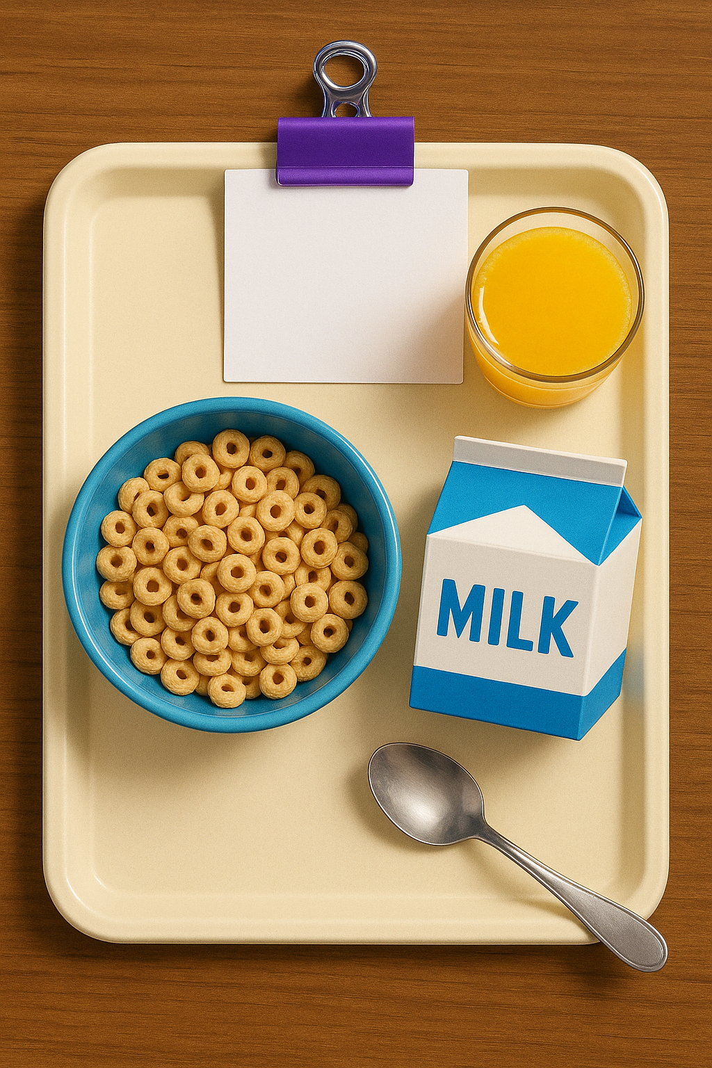
Meal Pattern Requirements: Offer Vs Serve, BREAKFAST
Sodexo
We offer 4 Items from 3 components (milk, grain, fruit, meat alternative)
Milk (8 fl oz) Juice or Fruit (1/2 cup)
Cereal or Muffin (1 serving, ¾ cup) Yogurt (meat alternative)
CAMPERS MUST TAKE 3!!

Slide 8
Meal Pattern Requirements: Offer Vs Serve, BREAKFAST
Sodexo
We offer 4 Items from 3 components (milk, grain, fruit, meat alternative)
Milk (8 fl oz) Juice or Fruit (1/2 cup)
Cereal or Muffin (1 serving, ¾ cup) Yogurt (meat alternative)
CAMPERS MUST TAKE 3!!

Slide 9
Meal Pattern Requirements: Offer Vs Serve, BREAKFAST
Sodexo
We offer 4 Items from 3 components (milk, grain, fruit, meat alternative)
Milk (8 fl oz) Juice or Fruit (1/2 cup)
Cereal or Muffin (1 serving, ¾ cup) Yogurt (meat alternative)
CAMPERS MUST TAKE 3!!

Slide 10
Meal Pattern Requirements: Offer Vs Serve, Lunch
Sodexo
We offer 5 Items from 4 components
Fruit/Vegetable: offer 2! salad or carrots or banana or watermelon
Milk Grain Meat/meat alternative
Campers Must Take 3!

Slide 11
Meal Pattern Requirements: Offer Vs Serve, Lunch
Sodexo
We offer 5 Items from 4 components
Fruit/Vegetable: offer 2! salad or carrots or banana or watermelon
Milk Grain Meat/meat alternative
Campers Must Take 3 components!
Count As 2: Grilled Cheese / Penne & Meatballs / Mac n Cheese / Pizza / Hamburger & Bun / Sandwich (2 oz protein: chicken or cheese + 1 serving/slice grain)
>> Count As 1: Chicken Fingers (2 oz protein, chicken or cheese)
Milk (8 fl oz)
Salad + Carrots or Cucumbers + Banana or Watermelon (1 serving)

Slide 12
Meal Pattern Requirements: Offer Vs Serve, Lunch
Sodexo
We offer 5 Items from 4 components
Fruit/Vegetable: offer 2! salad or carrots or banana or watermelon
Milk Grain Meat/meat alternative
Campers Must Take 3 components!

Slide 13
Meal Pattern Requirements: Offer Vs Serve, Lunch
Sodexo
We offer 5 Items from 4 components
Fruit/Vegetable: offer 2! salad or carrots or banana or watermelon
Milk Grain Meat/meat alternative
Campers Must Take 3 components!

Slide 14
Meal Pattern Requirements: Offer Vs Serve, Lunch
Sodexo
We offer 5 Items from 4 components
Fruit/Vegetable: offer 2! salad or carrots or banana or watermelon
Milk Grain Meat/meat alternative
Campers Must Take 3 components!

Slide 15
Meal Pattern Requirements: Offer Vs Serve, Lunch
Sodexo
We offer 5 Items from 4 components
Fruit/Vegetable: offer 2! salad or carrots or banana or watermelon
Milk Grain Meat/meat alternative
Campers Must Take 3 components!

Slide 16
CSDE… Monitor responsibilities
Duties and Authority include:
Nondiscrimination / Civil rights: Poster visible
Conduct site visits and reviews
Monitoring schedules, reporting and recordkeeping procedures
Follow-up procedures and office procedures
Local sanitation and health laws
Reporting racial/ethnic data
Personal safety precautions

Slide 17
Camp Shriver… Recordkeeping requirements
Daily recordkeeping requirements
Delivery receipts
Seconds, leftovers and spoiled meals
Daily labor- actual time spent on food service and time and attendance records
Collection of daily record forms
Maintain copies of meal service forms

Slide 18
Camp Shriver… Civil Rights Requirements
In accordance with Federal civil rights law and U.S. Department of Agriculture (USDA) civil rights regulations and policies, the USDA, its Agencies, offices, and employees, and institutions participating in or administering USDA programs are prohibited from discriminating based on race, color, national origin, sex, disability, age, or reprisal or retaliation for prior civil rights activity in any program or activity conducted or funded by USDA.
Persons with disabilities who require alternative means of communication for program information, should contact the Agency (State or local) where they applied for benefits. Individuals who are deaf, hard of hearing or have speech disabilities may contact USDA through the Federal Relay Service at (800) 877-8339. Additionally, program information may be made available in languages other than English.
Participants have a right to file a program complaint of discrimination, contact USA for more information online at: http://www.ascr.usda.gov/complaint_filing_cust.html or call (866) 632-9992.

Slide 19
Other policies/issues
What to do in inclement weather?
How to handle unauthorized adults eating meals?
Follow Camp Shriver procedures for:
Handling discipline / corrective action
Reviewing equipment, facilities and materials available for recreational activities
Trash removal requirements
Supervision for onsite consumption of meals

Slide 20
Other policies/issues
Nutrition and Health Education
Pre-planned menu follows MA DOE standards
Nutrition lessons happen informally throughout camp
Food safety/sanitation (UMass Amherst)
Clean, Separate, Cook, Chill
Food allergy awareness
9 Major Food Allergens: milk, eggs, peanuts, tree nuts, wheat, soybeans, fish, shellfish and sesame
Camp Shriver Health Services

Slide 21
The End!

