Slide 1
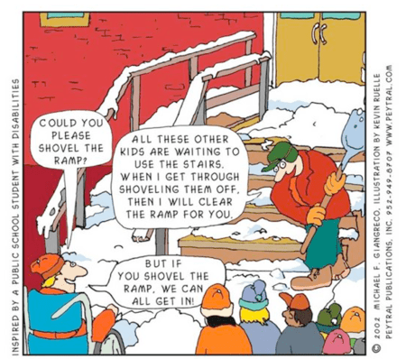
Camp Shriver: Best Practices for Inclusion at Camp
Mark Spolidoro
CENTER FOR SOCIAL DEVELOPMENT AND EDUCATION
UNIVERSITY OF MASSACHUSETTS BOSTON
Notes:
Introduction of myself!
Experience of folks in the room.
New
Returning 2-3 years
Returning 5 years
Returning 7 years or more

Slide 2
Defining the Three Levels of Inclusion
Social Inclusion
Functional Inclusion
Campers with disabilities fully participate in all camp activities and develop meaningful peer relationships
Physical Inclusion
Campers with disabilities have necessary supports to participate in all camp activities
Campers with disabilities are present at camp
Notes:
Stuart Schleien’s model
Physical inclusion
where campers with disabilities are present in the camp setting
involves making adaptations to the physical environment that would make it possible for a camper with a disability to be in that program
Building a ramp to enter the building
Functional inclusion
in addition to adaptations to the physical environment,
examples of some of the supports that will enable all to participate in every activity
Do they need a timer or a schedule board or a communication book?
Do they need check ins with a specific staff person?
Do they need a behavior management plan?
Social inclusion
not automatic
occurs when campers are socially accepted by their peers and are enabled by others to participate fully in camp activities
CAMPERS GET IN THE BUILDING, SUPPORTS ARE AVAIILBLE TO ALL PARTICIPANTS, ACTIVITES ARE USED TO PROMOTE SOCIAL INCLUSION
The activities at camp are used to promote social inclusion

Slide 3
Defining Social Inclusion
Social Inclusion
Full Participation
Social Connections
Notes:
Full Participation = Accessible Facilities
= Adaptable Equipment
Social Connection = Making friendships
= Sense of belonging
- increasing your sense of belonging is to look for ways you are similar with others instead of focusing on ways you are different.
For Example – Think about this…. Call a friend or family member to ask HOW they are doing and let them tell you about WHAT they are doing
(don't just talk about yourself, your own family and your own life, ensure they talk about their life, too)

Slide 4
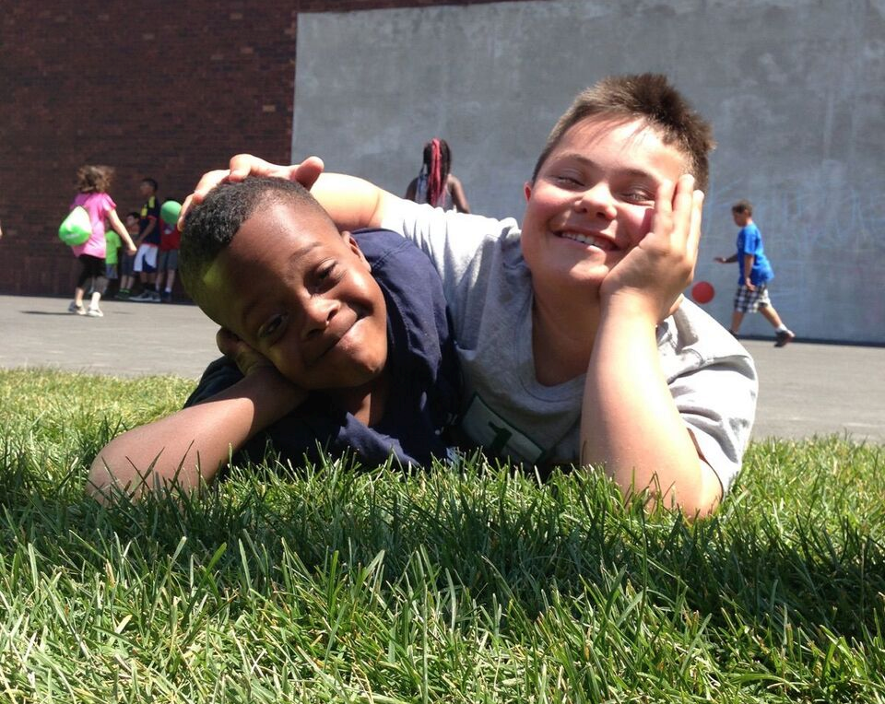
Fostering Social Inclusion
How you think about campers with and without disabilities
Expectations
Notes:
What are your expectations of your campers
All Campers will participate
All Campers will follow directions
All Campers will eat at the same time

Slide 5
Fostering Social Inclusion
How you think about campers with and without disabilities
Expectations
How you talk and communicate about inclusion
First person language
Notes:
People First Language respectfully puts the person before the disability;
SAY: INSTEAD OF:
People with a disability The Handicapped
She has Autism She is Autistic
He has Downs Syndrome He is Down’s
She uses a wheelchair She is confined to a wheelchair

Slide 6
Fostering Social Inclusion
How you think about campers with and without disabilities
Expectations
How you talk and communicate about inclusion
First person language
How you plan for inclusion
Intentionality
Notes:
Intentionality –
Being deliberate in what you do and say
Give directions like no one has ever played the game before
Use demonstrations and verbal ques to support the directions

Slide 7
Fostering Social Inclusion
How you think about campers with and without disabilities
Expectations
How you talk and communicate about inclusion
First person language
How you plan for inclusion
Intentionality
How you implement inclusion
Ongoing adaptations
Notes:
Ongoing adaptations
Change the rules or boundaries of a game
Size and weight of a ball – Use a balloon or beach ball instead of a volleyball – The game is played the same, the rules are the same, you just changed the speed of the game.

Slide 8
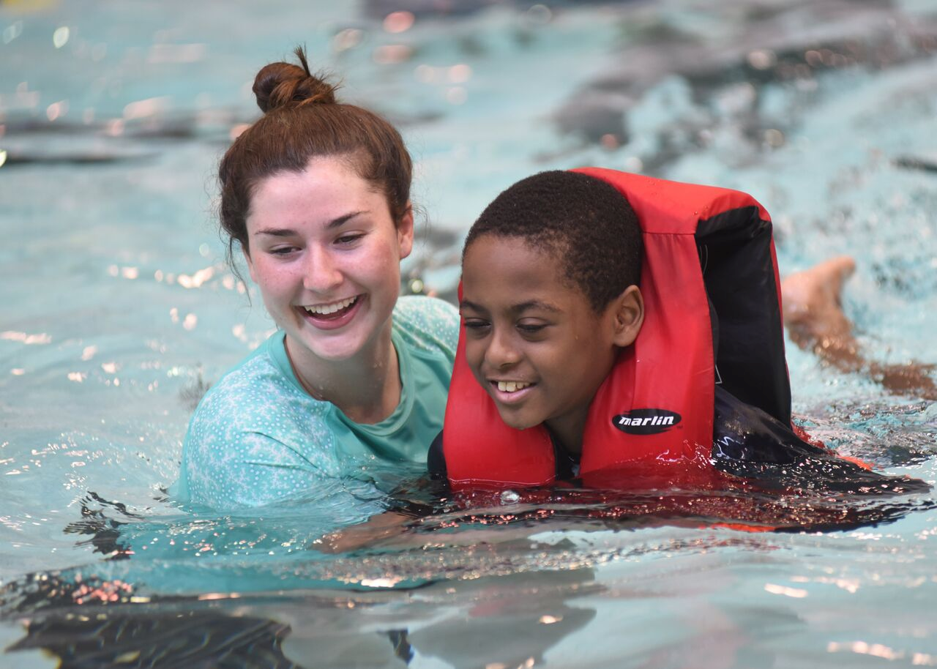
Knowing Your Campers
Who are your campers and where do they fall on the continuum?
CHALLENGING to EXEMPLARY
Physical skills
Social and emotional skills
Cognitive skills
Athletic skills
This will help you determine what each camper needs in terms of...
Program design
Support
Adaptions
Notes:
Every camper can be placed somewhere on the continuum from challenging to exemplary for each of these dimensions
For example, a camper may have exemplary athletic skills but challenging social skills
A camper is great at basketball and the best in camp but when he or she losses he melts down, has tantrum and blames all his teammates.
In the same game this 1 camper went from Exemplary to your most Challenging Camper in camp
Knowing your campers SKILLS will help all campers—those with a disability you can see/identify AND those you can’t see/identify
Gathering this information about your campers will help determine what EACH camper needs……..

Slide 9
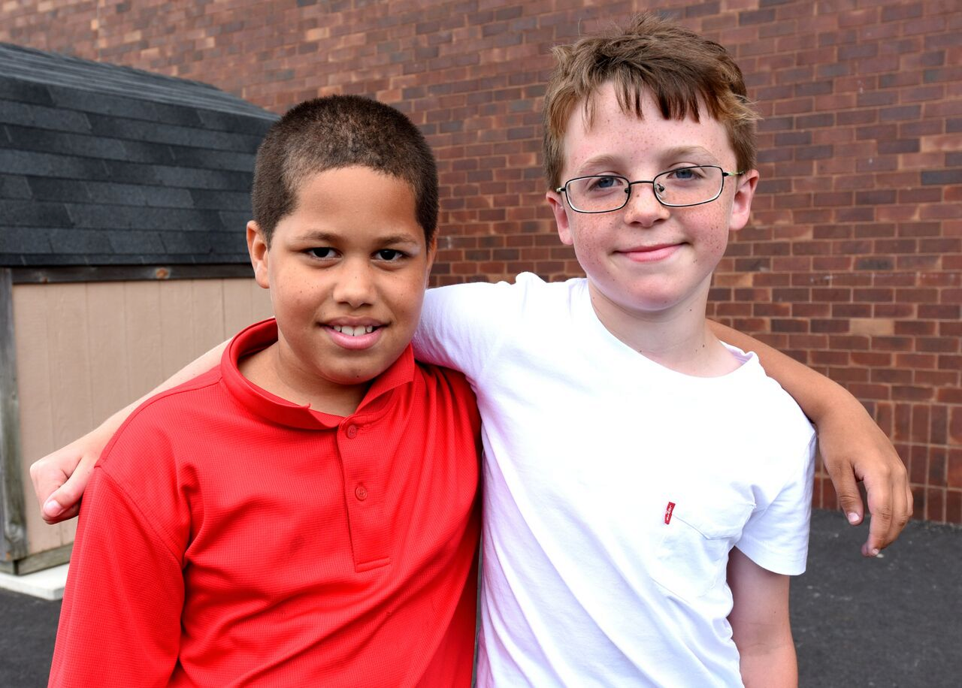
Developing an Inclusive Mindset
What does it mean to have an inclusive mindset at camp?
You believe that campers are more similar than different
Notes:
Inclusive mindset for counselors—setting expectations

Slide 10
Developing an Inclusive Mindset
What does it mean to have an inclusive mindset at camp?
You believe that campers are more similar than different
You believe that campers both with and without disabilities have unique skills and challenges
Notes:
Inclusive mindset for counselors—setting expectations

Slide 11
Developing an Inclusive Mindset
What does it mean to have an inclusive mindset at camp?
You believe that campers are more similar than different
You believe that campers both with and without disabilities have unique skills and challenges
You believe that accommodations and adaptations benefit campers both with and without disabilities
Notes:
YOUR INCLUSIVE MINDSET, LEADS TO SETTING EXPECTATIONS FOR ALL PARTICIPANTS

Slide 12
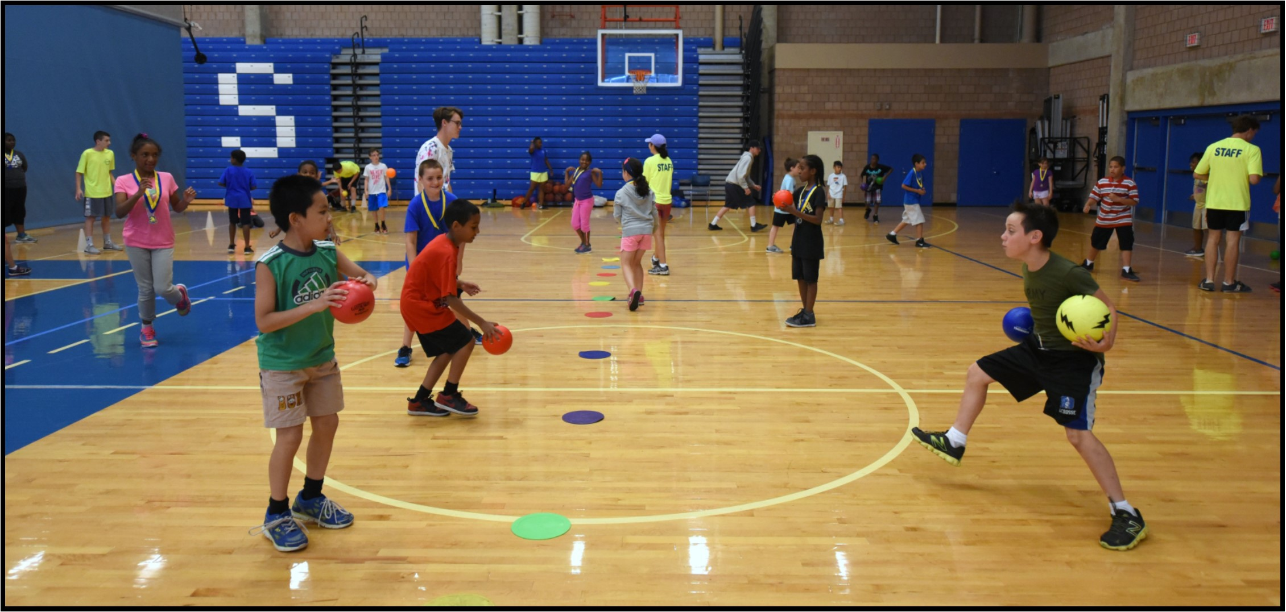
Counseling with an Inclusive Mindset
As a counselor with an inclusive mindset, you can help create a camp experience where...
ALL campers fully participate in camp activities
Notes:
Goals of counselors

Slide 13
Counseling with an Inclusive Mindset
As a counselor with an inclusive mindset, you can help create a camp experience where...
ALL campers fully participate in camp activities
ALL campers feel a sense of autonomy
Notes:
Goals of counselors

Slide 14
Counseling with an Inclusive Mindset
As a counselor with an inclusive mindset, you can help create a camp experience where...
ALL campers fully participate in camp activities
ALL campers feel a sense of autonomy
ALL campers feel they belong at camp
Notes:
Goals of counselors

Slide 15
Counseling with an Inclusive Mindset
As a counselor with an inclusive mindset, you can help create a camp experience where...
ALL campers fully participate in camp activities
ALL campers feel a sense of autonomy
ALL campers feel they belong at camp
ALL campers make friends
Notes:
THESE ARE YOUR GOALS AS A COUNSELOR –
IF YOU CAN GET HERE YOU HAVE CREATED A CAMP THAT IS INCLUSIVE AND YOU HAVE GIVEN EVERY CAMPER THE OPPORTUNITY TO BE SOCIALLY INCLUDED!

Slide 16
BEST PRACTICES
for Inclusion at Camp
Communication with Families
Facilities & Equipment
Programming
Notes:
Talking about best practices will demonstrate how important an “inclusive mindset” is to the success of camp
With this mindset, SOCIAL INCLUSION is possible
We will focus on three major domains of camp: communication with families, facilities and equipment, and programming

Slide 17
Best Practices: Communication with Families
Input from campers and their families is solicited so staff can plan for all campers based on their level of need and ability.
Notes:
Talk to families to see what they do at home, outside of camp or school time what works at home
Talk to your campers – both with and without disabilities
Camp Shriver: goals for campers through parent pre camp surveys and applications
Teacher surveys for both campers with and without disabilities (HANDOUT)
Camper IEP Review (HANDOUT)

Slide 18
Example: What Can You Ask Families?
Areas in which their child needs improvement
Making friends
Following directions
Being self-confident
Being patient
Joining a group of children playing
Asking other children to play
Goals they have for their child at camp
Notes:
These questions can be asked informally in conversations with parents, or more formally in a questionnaire that is sent out to parents before camp
Listen to the parents have to say – they are our biggest champion and our biggest critic
While listening think about their camper as he/she fits into the whole group
Being intentional in this process will help in the success of the camp experience

Slide 19
Best Practices: Communication with Families
Input from campers and their families is solicited so staff can plan for all campers based on their level of need and ability.
Feedback about the camper’s progress is provided to families throughout the program.
Notes:
Informal and formal progress is reported
We want to help parents see their camper in a new light
Take what they said and use that to our advantage
Share the good and challenging – give interventions being used
We want to raise the expectations of their camper
Direct family contact daily at pick up and drop off
Camp Shriver: weekly, bi-weekly, progress report Formal and Informal
Based on parent information from their pre-camp survey we report progress back to parent through a created progress report which looks similar to a progress report they get from their school.
On going with direct communication from administrative staff as necessary
Direct family contact daily at pick up and drop off

Slide 20
Best Practices: Facilities & Equipment
Program buildings, facilities, and structures are made accessible to all campers.
Notes:
Meet ADA guidelines – Administration responsibility
Does YOUR accommodation meet the needs of your campers? Ex. Adding a water table to support swimmers in a deeper pool
Do the facilities meet YOUR needs?
Wheel chair doesn’t fit through the closest main door, everyone goes through the door which can accommodate all!
THINGS WE CAN DO ON THE GROUND WITH OUR CAMPERS

Slide 21
Example: Snow Shoveling Cartoon
Notes:
Do you remember the cartoon from the very first slide?
ARE YOU BEGINNING TO SEE HOW THIS MAKE SENSE AND THE KIDS ARE RIGHT

Slide 22
Best Practices: Facilities & Equipment
Program buildings, facilities, and structures are made accessible to all campers.
Dedicated or flexible sensory-friendly spaces are planned for “cool down” or “chill out” times.
Notes:
Should be a safe, obstruction free environment
Away from main areas of activity but still accessible to all, visible by some!
Physical activity leading to the space
Wall push ups
Jumping jacks
5 deep breaths
Camper will be better in control when they get to the space.
Travel Calm Down Kits
Sensory rooms are great, but true inclusion happens in the field
Packing list:
Group schedule (visual) with Now/Then clip
Mini sand timer
Play-doh
Simple fidget
Squishy fidget
Bubbles
For younger kids— coloring pages, crayons, stickers

Slide 23
Best Practices: Facilities & Equipment
Program buildings, facilities, and structures are made accessible to all campers.
Dedicated or flexible sensory-friendly spaces are planned for “cool down” or “chill out” times.
Accommodations to facilities, equipment, and activities avoid stigmatizing campers with disabilities.
Notes:
Colored tablecloths match the team’s colored shirts bags
Having various sizes, shapes, weights, and colors of equipment available to all campers
Multiple distances from targets for all campers to choose from

Slide 24
Best Practices: Facilities & Equipment
Program buildings, facilities, and structures are made accessible to all campers.
Dedicated or flexible sensory-friendly spaces are planned for “cool down” or “chill out” times.
Accommodations to facilities, equipment, and activities avoid stigmatizing campers with disabilities.
Accommodations to facilities, equipment, and activities are made as needed on an ongoing basis.
Notes:
You WILL NOT be able to plan for everything, you may have to wing it! BUT HAVE A PLAN!!!!
IT IS AN ATTITUDE!!!
ADAPT, OVERCOME AND IMPROVISE
Line on basketball court activity
No matter how much directors plan, YOU ARE THE FRONT LINES
PLANNING FOR THE CAMPER MOST IN NEED BENNIFTS ALL!

Slide 25
Best Practices: Facilities & Equipment
Program buildings, facilities, and structures are made accessible to all campers.
Dedicated or flexible sensory-friendly spaces are planned for “cool down” or “chill out” times.
Accommodations to facilities, equipment, and activities avoid stigmatizing campers with disabilities.
Accommodations to facilities, equipment, and activities are made as needed on an ongoing basis.
All counselors provide the necessary support to ensure that all campers can fully and safely participate.
Notes:
Limit identifications as “you are responsible for campers D, E, and F in the group” (Campers D, E and F have a disability)
Inclusion is EVERYONE’S responsibility

Slide 26
Best Practices: Programming
Planning begins with campers with the “highest level of need” to ensure that all campers will be included.
Notes:
Multi-sensory approach (visual, auditory, tactile)
Schedule boards and visual timers (see next slide)
Routines that benefit all!!!
Morning meeting, closing meeting, lunch time

Slide 27
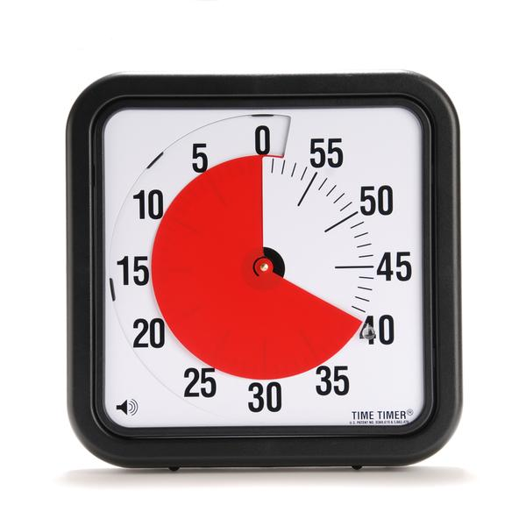
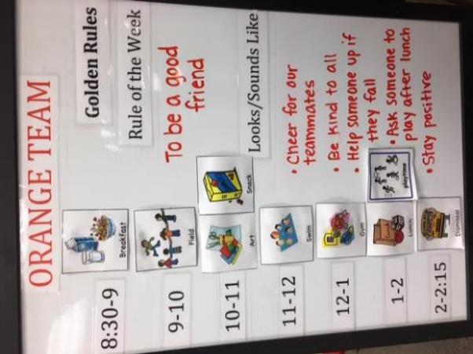
Example: Schedule Board & Visual Timer

Slide 28
Best Practices: Programming
Planning begins with campers with the “highest level of need” to ensure that all campers will be included.
At the beginning of camp, counselors prepare campers for the social acceptance and understanding of their peers with disabilities.
Notes:
This is about empowering the campers to be inclusive and commit to not leaving any of their peers behind—and creating that CULTURE from day one.
Strategies for bringing a peer who’s sitting alone into a group and creating a sense that we are all a team together, we’re all going to work on this together, etc.
DEMONSTRTE WHAT THIS LOOKS LIKE
WHAT IS ACCEPTABLE WHAT IS NOT
Defining “friends” very broadly and understanding that there are different levels of friendship.
Friends = A BOND – Could be over athletic ability, we look the same, we go to the same school, live on the same street……
Sometimes it’s about helping, sometimes it’s about being social...

Slide 29
Best Practices: Programming
Planning begins with campers with the “highest level of need” to ensure that all campers will be included.
At the beginning of camp, counselors prepare campers for the social acceptance and understanding of their peers with disabilities.
Transitions between and within activities are intentionally planned by counselors to encourage and support positive social interactions and the development of positive social relationships.
Notes:
Discussed and practiced during orientation (being very intentional)
Set up a scenario – use returning staff!
During activity – start and stop in same location, countdown timer, Red, Yellow, Green card system
Verbal cues
(Share visual que colored cards)

Slide 30
Best Practices: Programming
Planning begins with campers with the “highest level of need” to ensure that all campers will be included.
At the beginning of camp, counselors prepare campers for the social acceptance and understanding of their peers with disabilities.
Transitions between and within activities are intentionally planned by counselors to encourage and support positive social interactions and the development of positive social relationships.
During activities, counselors model behavior that reflects a culture of fair play, equity, and the inherent value of all campers to promote a sense of belonging.
Notes:
Moving from competitive games to cooperative activities promotes teamwork, sportsmanship, allows for participation by all
Modified kickball (ultimate ball) – describe it
Show next slide (transition box) and talk through benefits

Slide 31
Best Practices: Programming
Planning begins with campers with the “highest level of need” to ensure that all campers will be included.
At the beginning of camp, counselors prepare campers for the social acceptance and understanding of their peers with disabilities.
Transitions between and within activities are intentionally planned by counselors to encourage and support positive social interactions and the development of positive social relationships.
During activities, counselors model behavior that reflects a culture of fair play, equity, and the inherent value of all campers to promote a sense of belonging.
Counselors promote campers’ autonomy by offering them choices.
Notes:
Cooperation, feeling of success
Gives opportunities for social groups to form naturally through unstructured activities
Free time after lunch— campers have an opportunity to select from games played and taught throughout camp as well as others like jump rope, 4 square, wall ball, etc.
Campers get to work freely across teams and disabilities
Counselors should try to aid and fade

Slide 32
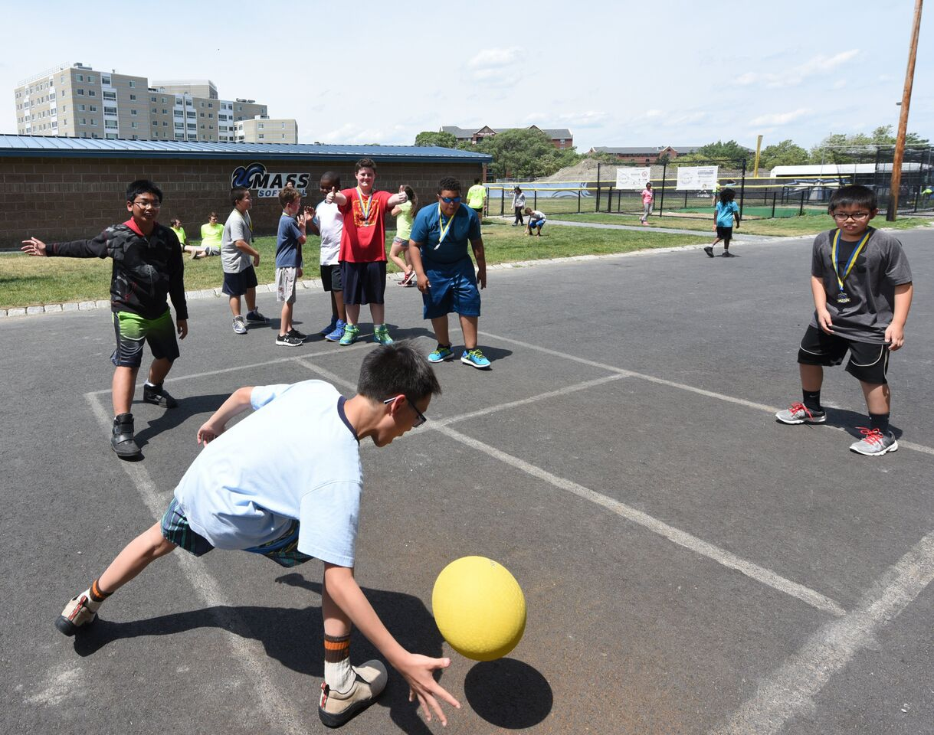
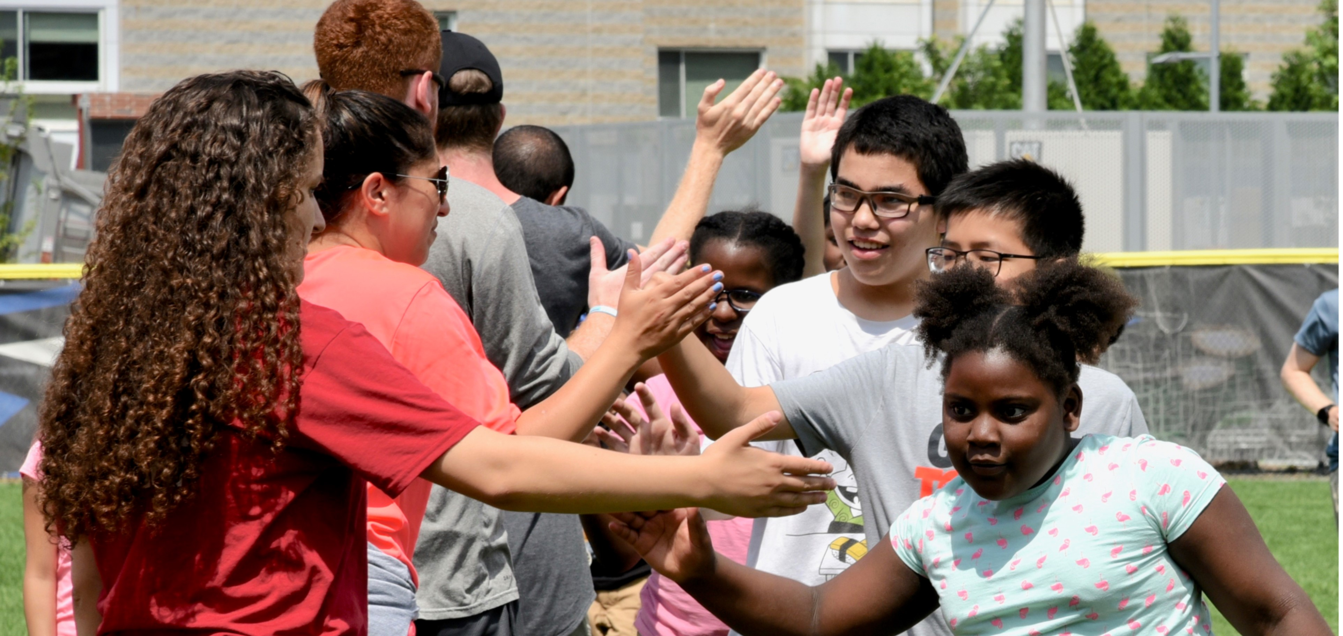
Key Takeaways
Inclusion is everyone’s responsibility!
Inclusion is possible!
Notes:
WHEN WE COMIT TO HAVING AN INCLUSIVE MINDSET AND WORK TOGETHER TOWARD THE SAME GOAL SOCIAL INCLUSION IS POSSIBLE!!!

Slide 33
Inclusion In Action

Slide 34
How Can I Help?
Mark Spolidoro
Camp Shriver Director
Center for Social Development and Education
Mark.Spolidoro@umb.edu
University of Massachusetts Boston
www.umb.edu/csde
(617) 287-7250

