Slide 1
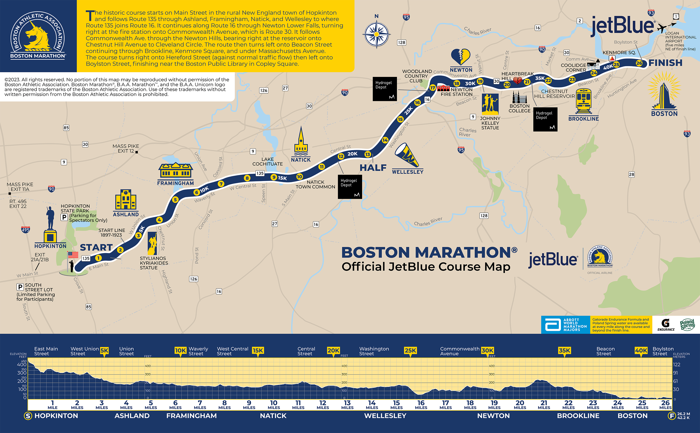
DIRECTIONS
Use slide 2 – set up with your finish line fundraising goal
Make a couple copies so it’s easier to edit/see prompts
Do the math (% of funds raised to goal, multiply that by 26.2 to identify where you are on the map – look to mile markers )
Add updated stats to the right side of the map (highlighted here for visibility)
Move red pin and “I’m here” logo to match progress
Update statements on either side of map
When slide finalized – go to “file” “export” and change “file format” to “JPEG”, select “current slide only and the picture file will save to current/designated folder location.
When I post I use the bottom space to tag those who have donated
AS A CHARITY RUNNER, I HAVE TWO FINISH LINES TO CROSS.
Here is my current progress in reaching my goal to support another summer of Camp Shriver! Please help me reach my fundraising finish line before I go to the real starting line in April! / xx days/weeks to go
$12,000
I’M HERE!
$1,599 RAISED,
13% OF MY GOAL
$0
In fundraising world, I have reached TOWN/LANDMARK/AREA! ADD STATEMENT ABOUT AREA/FOCUS /Feeling

Slide 2
AS A CHARITY RUNNER, I HAVE TWO FINISH LINES TO CROSS.
Here is my current progress in reaching my goal to support another summer of Camp Shriver! Please help me reach my fundraising finish line before I go to the real starting line in April! / xx days/weeks to go
$12,000
I’M HERE!
$3,329 RAISED,
27% OF MY GOAL
$0
In fundraising world, I have reached TOWN/LANDMARK/AREA! ADD STATEMENT ABOUT AREA/FOCUS /Feeling
THANK YOU TO EVERYONE THAT HAS DONATED TO GET ME HERE!
Notes:
Build from this template, copy one

Slide 3
AS A CHARITY RUNNER, I HAVE TWO FINISH LINES TO CROSS.
I’ll be tracking my fundraising for Camp Shriver along the course map to show my progress. Please help me reach my fundraising finish line before I go to the real starting line in April!
$12,000
I’M HERE!
$1,599 RAISED,
13% OF MY GOAL
$0
In fundraising world, I have reached Ashland! I’m happy to be here with a solid start to keep me feeling optimistic for this journey, but I have a long way to go!
THANK YOU TO EVERYONE THAT HAS DONATED SO FAR!
Notes:
EXAMPLE

Slide 4
AS A CHARITY RUNNER, I HAVE TWO FINISH LINES TO CROSS.
Here is my current progress in reaching my goal to support another summer of Camp Shriver! Please help me reach my fundraising finish line before I go to the real starting line in April. Eighteen weeks to go!
$12,000
I’M HERE!
$3,329 RAISED,
27% OF MY GOAL
$0
In fundraising world, I have reached Framingham! This is a very special area as it is where I began my career as a special education teacher. Camp Shriver fosters an environment that matches so many of my personal values through their inclusive model and I’m grateful to have been selected to support them this year!
THANK YOU TO EVERYONE THAT HAS DONATED TO GET ME HERE!
Notes:
EXAMPLE

Slide 5
AS A CHARITY RUNNER, I HAVE TWO FINISH LINES TO CROSS.
Here is my current progress in reaching my goal to support another summer of Camp Shriver! Please help me reach my fundraising finish line before I go to the real starting line in April! 115 days to go
$12,000
I’M HERE!
$3,754 RAISED,
31% OF MY GOAL
$0
In fundraising world, I am in Framingham closing in on Natick!
THANK YOU TO EVERYONE THAT HAS DONATED TO GET ME THIS FAR!
Notes:
EXAMPLE

