Slide 1
SUMMIT Fiscal Management of Sponsored Programs
How to use the SUMMIT Reporting Tool to effectively manage your sponsored funding
Office of Research & Sponsored Programs (ORSP)

Slide 2
Topics:
SUMMIT Basics
  Access, Logging In, Navigation, Summary Page
Sponsored Activity Page
  Prompts, Encumbrances, F&A, Reporting
Resources
  Ongoing training and how to get help

Slide 3
SUMMIT – The Basics
What is SUMMIT?
  SUMMIT is the enterprise reporting tool for the UMass system
  SUMMIT delivers PeopleSoft data quickly and easily
  …if you know how to use it effectively
What do I need to know?
    SUMMIT is not dynamic
  It is updated nightly through a data feed from PeopleSoft
    Beware the Dunning-Kruger effect!
  It is important to truly understand your data in SUMMIT
  Utilize your resources – Departmental and ORSP
  Your support staff are well versed in institutional policy and process as well as how to navigate the complex compliance concerns that are associated with sponsored programs.
Notes:
Dunning-Kruger: An overestimation of capability, opposite is Imposter Syndrome

Slide 4
SUMMIT – The Basics: Access & Login
How do I get access?
  As a PI, you should have access to SUMMIT
    Use your regular login credential (same as email and HR)
    You will only see what you have permission to view
  If you cannot access to SUMMIT
    Complete the CON-15 Form here: Controller Forms
How do I login?
  SUMMIT is accessible from the following webpages:
    ORSP Training and Tools & Resources
    UMass Boston Administration & Finance › Web Applications
    UMPO UITS Product Catalog
Notes:
CON15 Form through Controller’s Office if you cannot log into SUMMIT and can still log into other UMB applications. If you are not seeing data you expect to see, that is a permissions issue. SUMMIT data access is the same as PeopleSoft and is typically Department ID based.

Slide 5
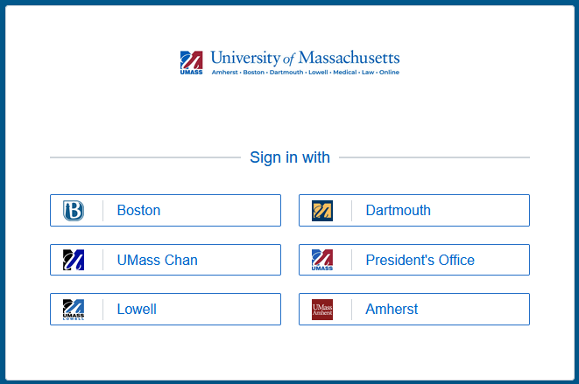
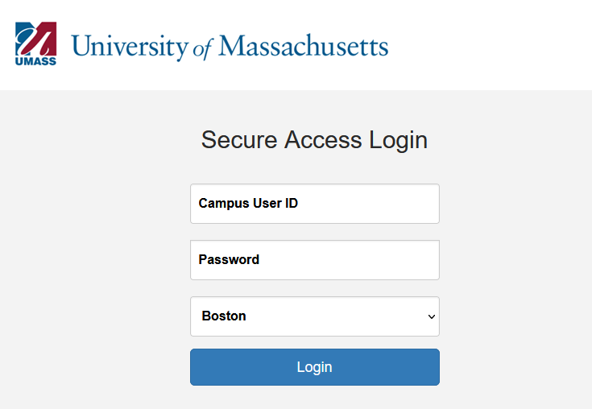
SUMMIT – Logging In
The SUMMIT link brings you to the login page
  Use your regular login credentials

Slide 6
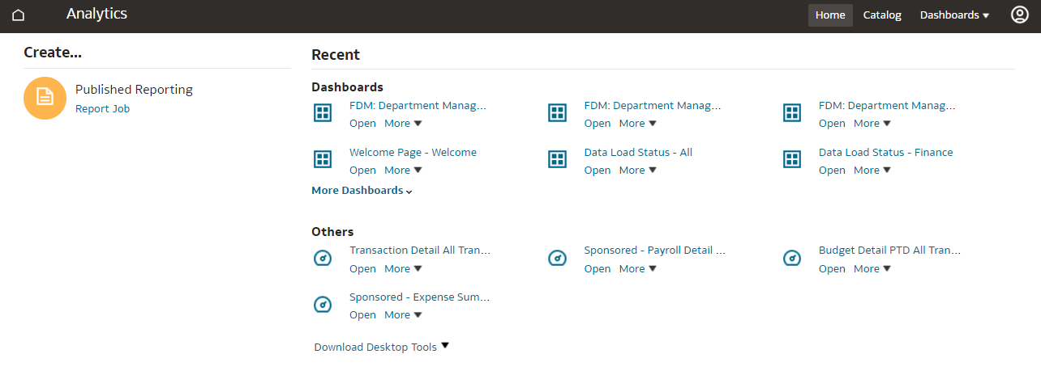
SUMMIT – Landing Page
Shows the recent areas you have visited, click to open or
Navigate to Dashboards using the dropdown menu on the upper right toolbar

Slide 7
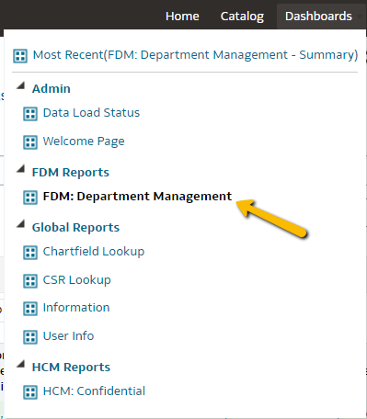
SUMMIT – Dashboard Menu
SUMMIT Dashboards dropdown menu:
Dashboards you have access to will be available to select
Click FDM: Department Management

Slide 8

SUMMIT – Dashboards
SUMMIT Dashboards – What are they?
  Dashboards are a collection of interactive tools called ‘widgets’ designed to enable end users to run ad-hoc reports and perform personalized analysis
  UMass has designed the FDM: Financial Department Management dashboard to provide a variety of tools for managing various fiscal areas, including sponsored projects
  When accessing the FDM: Department Management Dashboard from the menu bar, you will always default to the Summary tab

Slide 9
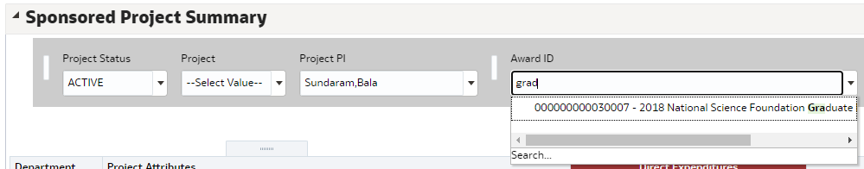
SUMMIT – The Summary Tab
Navigating SUMMIT Dashboards – The Summary Tab
  On the Summary tab, scroll down to Sponsored Project Summary
  What you can view is based on your access in PeopleSoft Finance
  Type directly in the filter areas to narrow your results, once a filter is filled in, data available in additional filter fields is constrained by the selections already made
  You don’t have to search using exact numbers

Slide 10
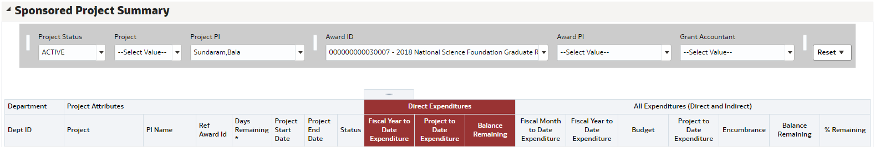
Sponsored Project Summary on the Summary Tab
SUMMIT – The Summary Tab
Sponsored Project Summary on the Summary Tab
  This area provides a quick view of your sponsored projects
  Note the red section is Direct Expenditures only
  The All Expenditures section to the right of Direct Expenditures is inclusive of direct and indirect charges to your project
  This section of the Summary tab is helpful, but the detail available here is limited

Slide 11

Alerts on the Summary Tab
SUMMIT – The Summary Tab
Alerts on the Summary Tab
  On the Summary tab, scroll down to the Alerts Based on Today’s Date
  For Sponsored Projects, the following alerts will populate if there is data present for your projects
    In Deficit
    With Balances Greater than 25% or 50%

Slide 12
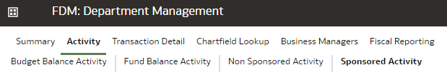
SUMMIT – Sponsored Activity
Navigating SUMMIT Dashboards – Sponsored Activity
  Click the Activity tab, and Sponsored Activity page
  You can also navigate directly the Sponsored Activity by clicking on the project hyperlink from the Summary page

Slide 13
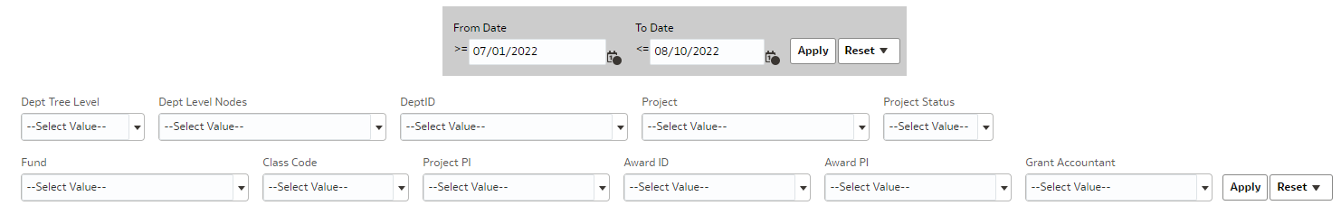
Filters on the Sponsored Activity Page
SUMMIT – Sponsored Activity
Filters on the Sponsored Activity Page
  Here you will see a series of filters to define your search criteria
  Note there are two filter sections, each with their own Apply and Reset buttons, the date range section is in gray
  You must click the Apply button for each section separately after you populate the filters in those sections
Notes:
Populate the filters, then click apply

Slide 14
SUMMIT – Filters
Date Filters on the Sponsored Activity Page
  These dates always default to:
    From Date – beginning of the current fiscal year
    To Date – today’s date
    Remember that SUMMIT data is always one day behind
  These dates control the data that returns in the ‘Selected Date Range Expenditures’ Column in the Sponsored Activity Expenditure Summary section and the data that is pulled into the Sponsored Project Expenditures for Selected Dates report under Detail Transaction Reports
  Data is pulled in by Accounting Date and Journal Date
    Payroll adjustments will show in the date range the adjustment was applied
Notes:
If you are not finding transactions you expect to see, try widening your date filter and don’t forget to hit apply. Payroll adjustments will be visible based on the paydate the adjustment was applied.

Slide 15
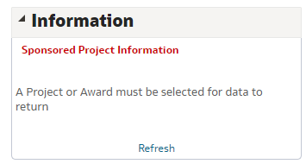
Filters on the Sponsored Activity Page: Information Box
SUMMIT – Filters
Filters on the Sponsored Activity Page
  When you first navigate to the Sponsored Activity Page, filters other than the date filters will be blank and if you have more than one Award, nothing will be populated in the Information box on the left
  Once a Project or Award is selected, this box will fill in with your Award details

Slide 16
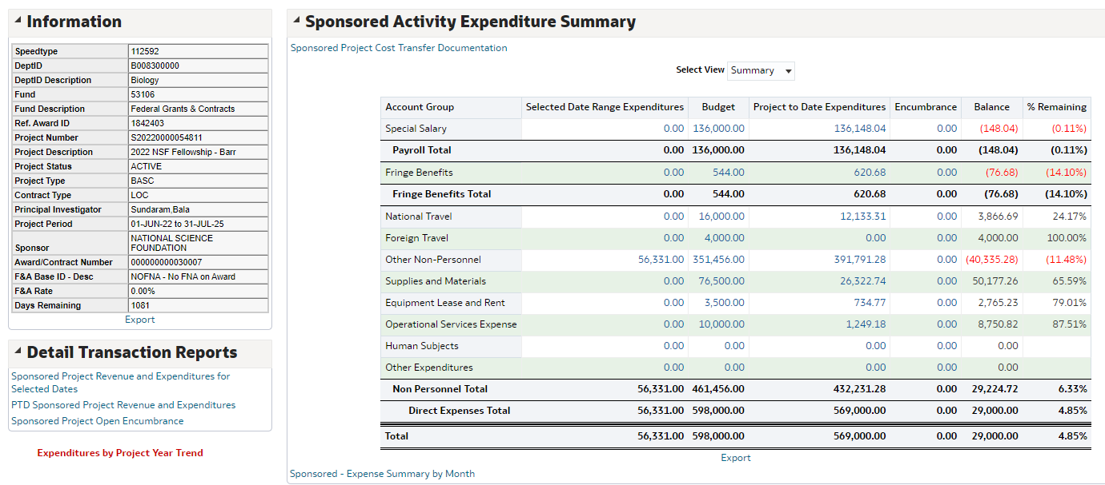
Filters on the Sponsored Activity Page: Expenditure Summary
SUMMIT – Filters
Filters on the Sponsored Activity Page – Expenditure Summary
  The Sponsored Activity Expenditure Summary section returns summarized values based on the filtered data
  Until filter values are populated, this data will be inclusive of everything you have access to
Here we see the Sponsored Activity Expenditure Summary section and the Information section populated
Notes:
Summarized data is inclusive of all projects for multi-project awards unless a specific project is selected in the filter, even when a project numbers shows on the Information section. The project number in the Information section always defaults to the project assigned as primary for multi project awards if a different specific project is not selected.

Slide 17
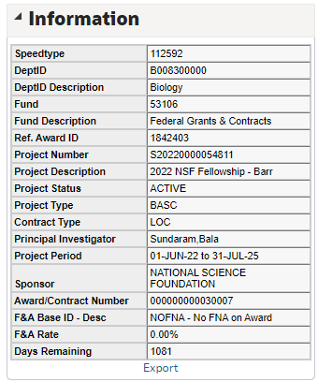
SUMMIT – Information Section
Filters on the Sponsored Activity Page – Information Section
  The Information section shows your Award details, including:
    Sponsor, Start and End Dates, PI, F&A Rate, Title…
  Note – if an Award has multiple projects, the Primary Project information will default in, select a specific Project to view details for Projects other than the primary
Notes:
The Note here applies to multi-project awards (see previous slide for additional information)

Slide 18
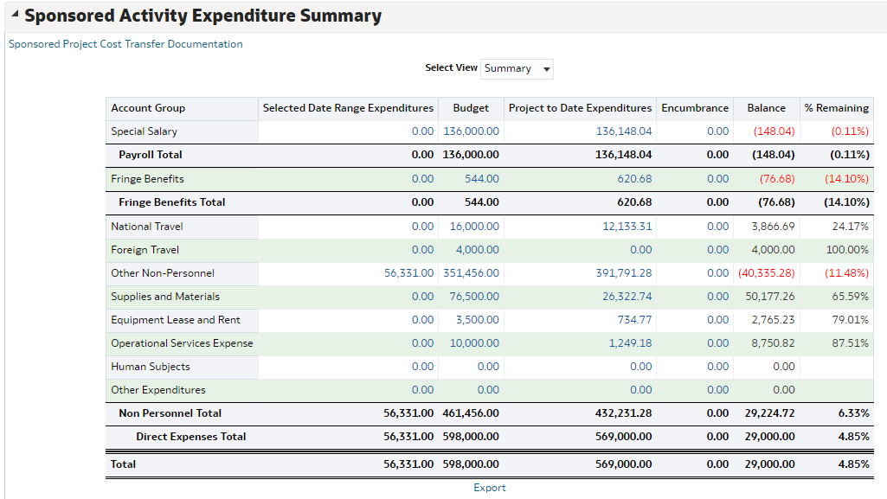
SUMMIT – Expenditure Summary
Filters on the Sponsored Activity Page – Expenditure Summary
  The Sponsored Activity Expenditure Summary section provides a summary view of your Award Budget, Expenditures, Encumbrances, and Remaining Balance
  Note the Selected Date Range Expenditures include costs applied that fall within the date range filters – To and From dates in the grey box at the top
  All hyperlinked numbers are drillable, click the number to see detail
Remember - Data is pulled in by Accounting Date and Journal Date

Slide 19
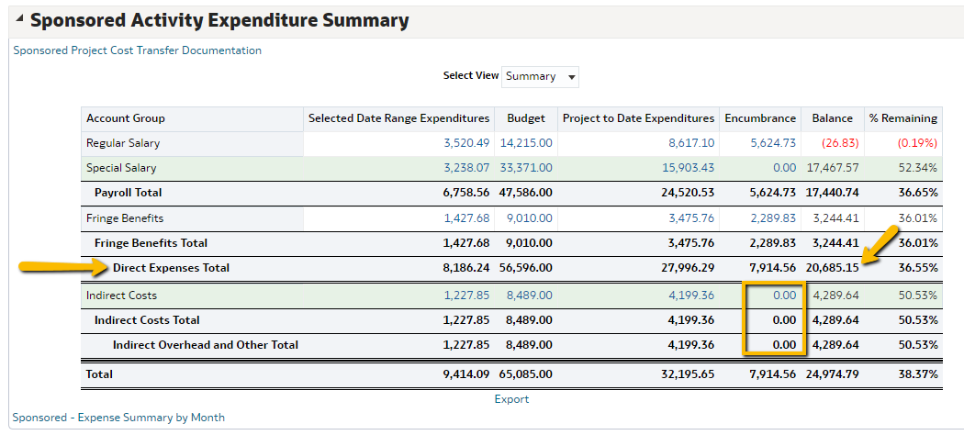
Encumbrances
SUMMIT – Expenditure Summary
  Note the Encumbrance column does NOT encumber F&A, always look at your Direct Expense Total for the true Balance Available that you have remaining for direct costs
Notes:
Encumbrances are added when a PO is created or when payroll is assigned to a project with a future end date. Currently PeopleSoft and SUMMIT do not have the ability to encumber associated F&A (overhead) charges that will be applied when the encumbered costs go through as actual expenses. Therefore, the bottom Balance Total IS misleading if encumbrances exist on your project. Always look at your Direct Expense Total for the true Balance Available that you have remaining for direct costs.

Slide 20
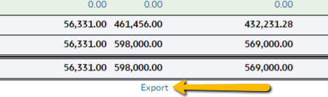
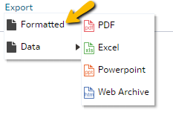
Exporting Reports
SUMMIT – Expenditure Summary
Sponsored Activity Expenditure Summary - Exportable
  The Sponsored Activity Expenditure Summary section can be exported by clicking the Export link
  Export to either Excel or PDF, use the Formatted export function
Notes:
This is applicable to any section that has that Export link available. The hands-on training will go into more detail on exporting reports.

Slide 21
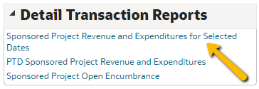
SUMMIT – Detail Transaction Reports
Reporting in SUMMIT – Detail Transaction Report for Selected Date Range
  Returns a detailed listing of all expenditures that fall within the filter date range
  Can be downloaded into Excel or as a PDF
  Totals in each category will match the Expenditure Summary section
  This is a great way to review expenses for financial reporting, or to see if an expected expense has posted
Notes:
The hands-on training will go into more detail on exporting reports.

Slide 22
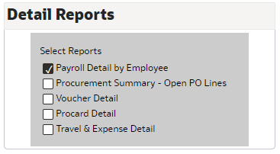
SUMMIT – Detail Reports
Reporting in SUMMIT – Detail Report Section
  Additional Reports are available at the bottom of the page in the Detail Reports section
  These reports only show if you check the box, this is the cut down on page load times

Slide 23
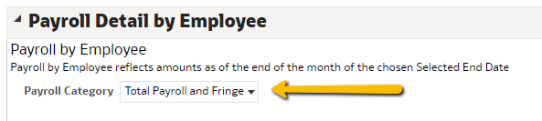
Payroll Detail by Employee
SUMMIT – Detail Reports
Reporting in SUMMIT – Payroll Detail by Employee
  Available by Payroll, Fringe, and Total Payroll and Fringe
  Provides list by Employee, includes HR Encumbrance End Date

Slide 24
SUMMIT – Resources
Ongoing Training
  See ORSP Training webpage where you can:
    Sign up for future training sessions
    Attend scheduled drop-in sessions
  Additional group and one on one training is available upon request
Resources
  Please reach out to Ginny Maki with any Sponsored Project related SUMMIT questions
  Copies of this presentation can be emailed
  Contact: Virginia.Maki@umb.edu
Office of Research & Sponsored Programs (ORSP)

